Slide 1
Atlas Meeting 7
Yihao Chen

Slide 2
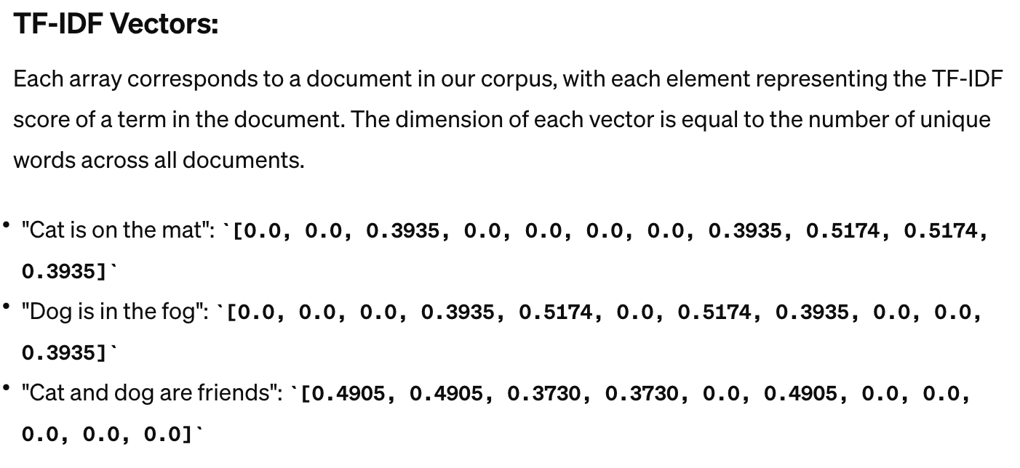
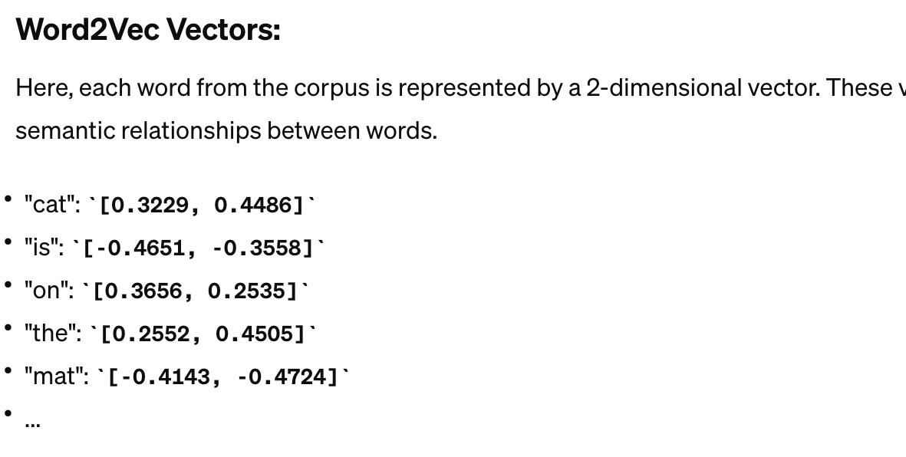
Machine learning model
TF-IDF vector
  More direct representation in documents level
  Less computational cost
Word2Vec

Slide 3
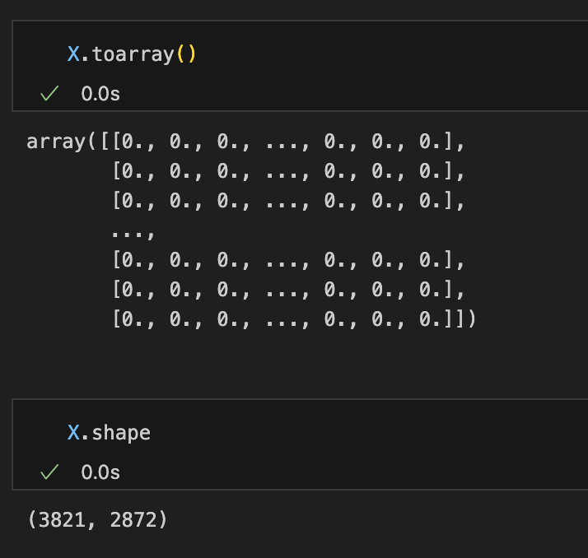
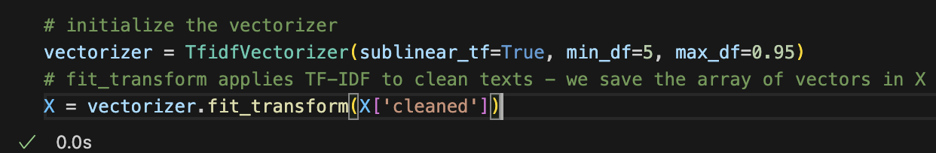
Machine learning model
TF-IDF vector
  More direct representation in documents level
  Less computational cost
Word2Vec

Slide 4
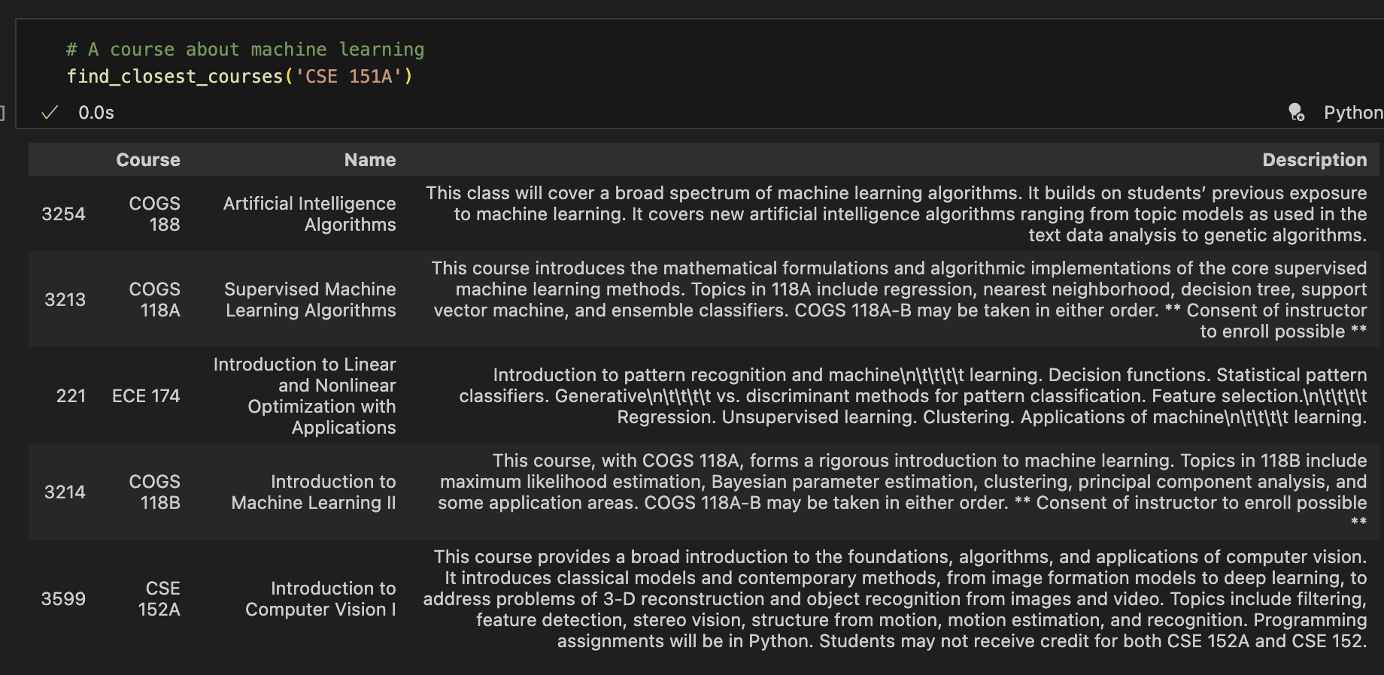
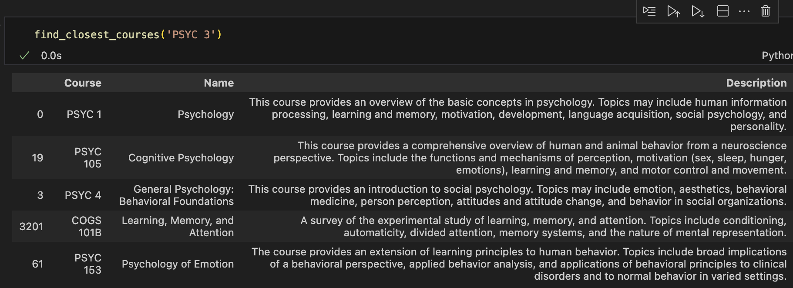
Progress
Initial recommendation
Similar courses from multiple majors are found.

Slide 5
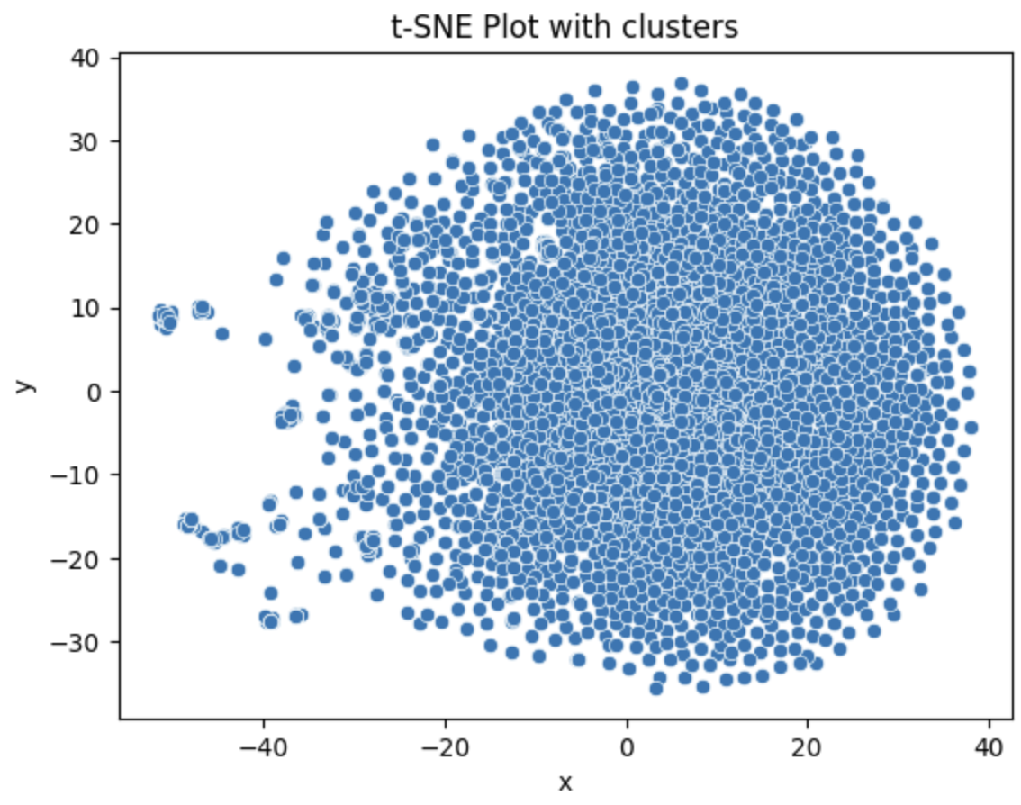
Way of visualization

Slide 6
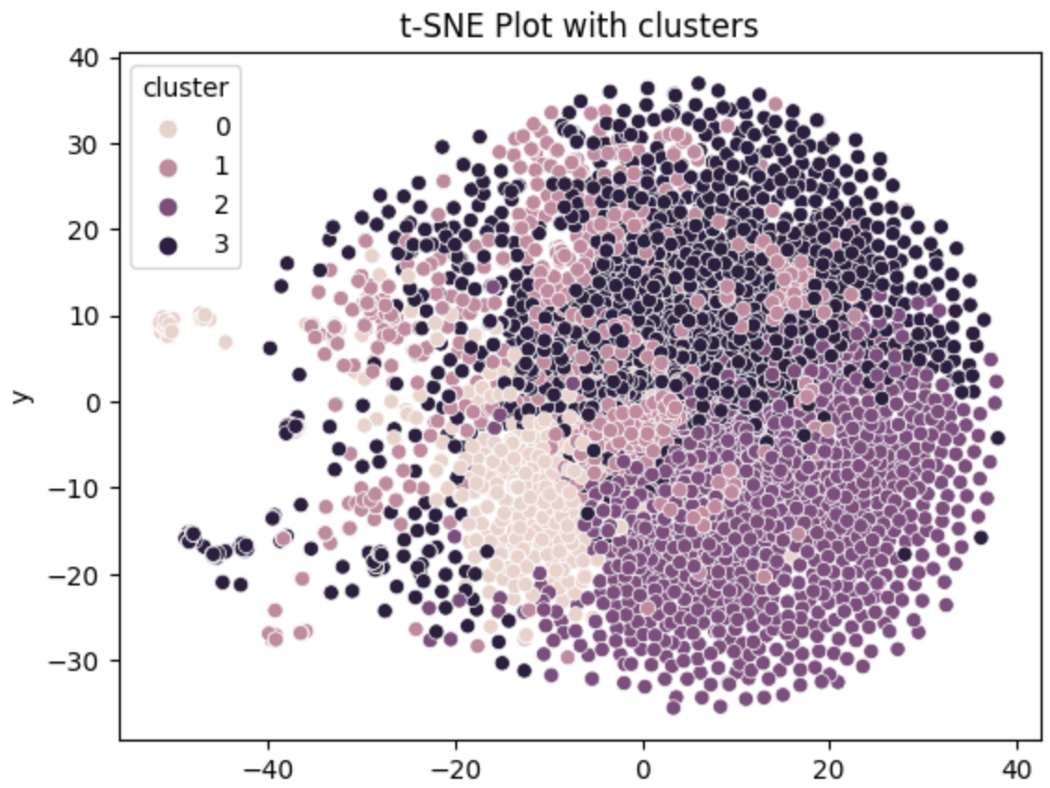
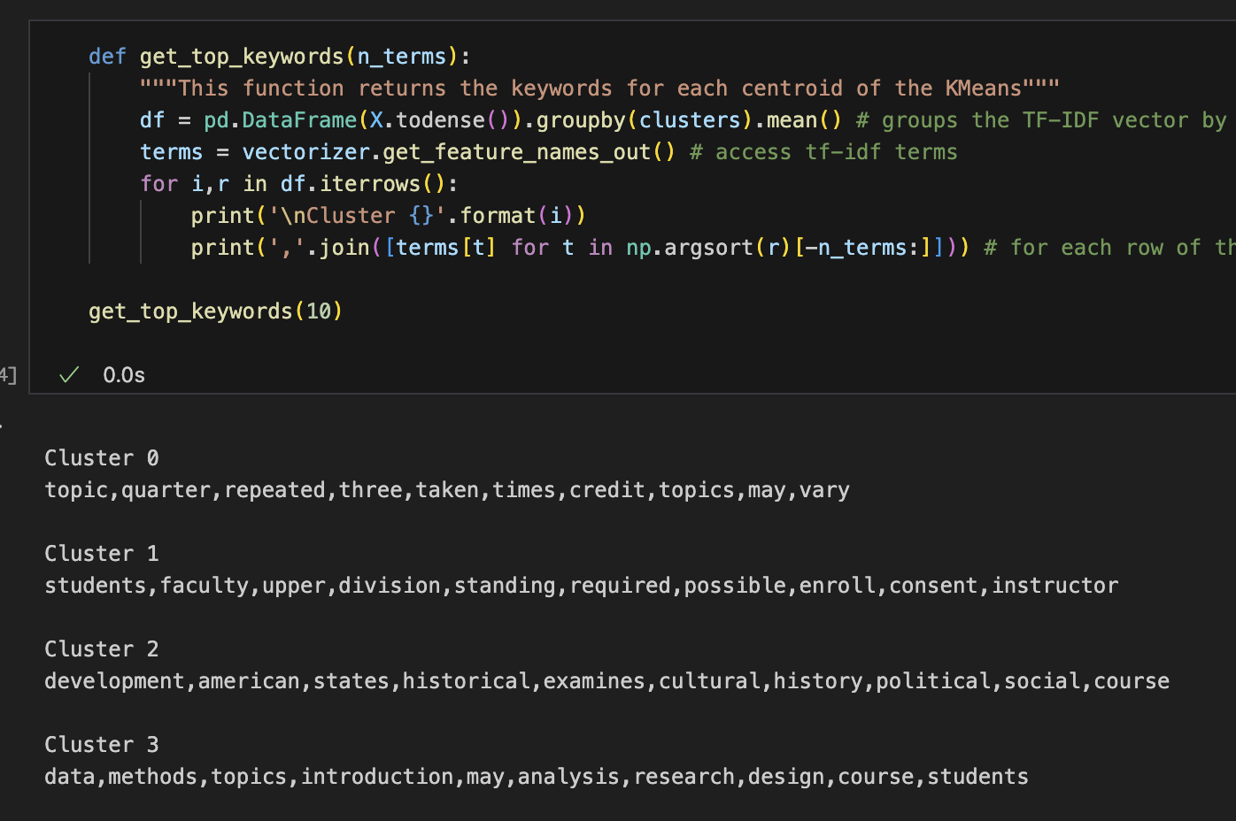
Check model prediction
Clustering anlaysis – use K-Mean

Slide 7
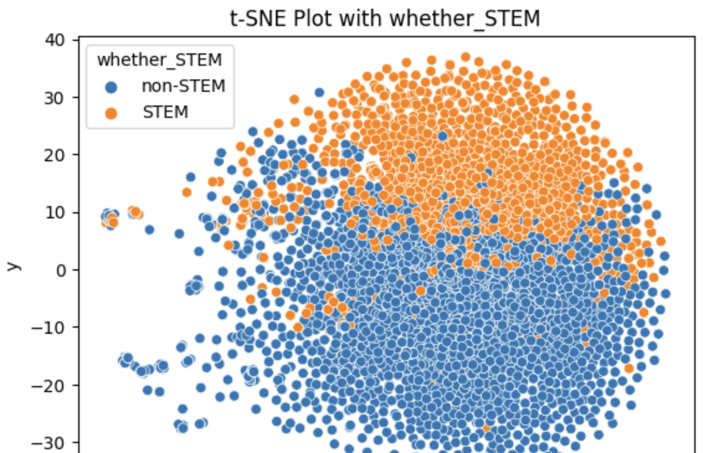
Check model prediction
Cluster 2 keywords – Humanities & social science like development,american,states,historical,examines,cultural,history,political,social,course
Cluster 3 keywords – more STEM like
data,methods,topics,introduction,may,analysis,research,design,course,students

Slide 8
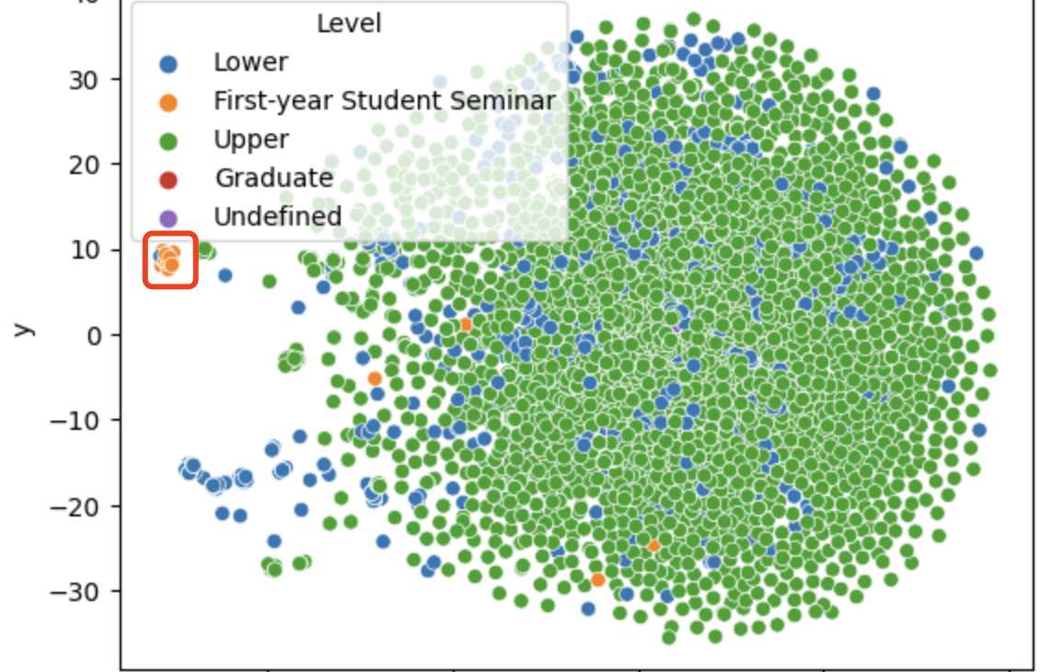
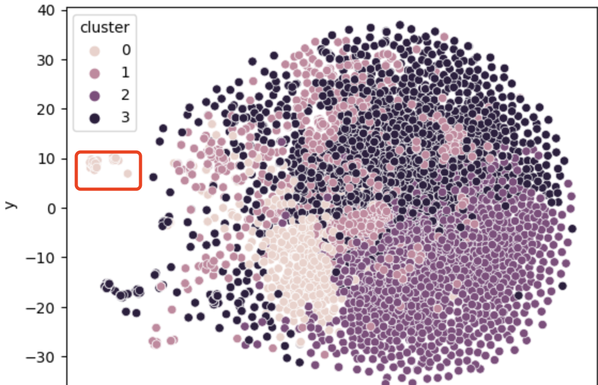
Check model prediction
t-TSNE K-Means insights
Cluster 0 topic,quarter,repeated,three,taken,times,credit,topics,may,vary

Slide 9
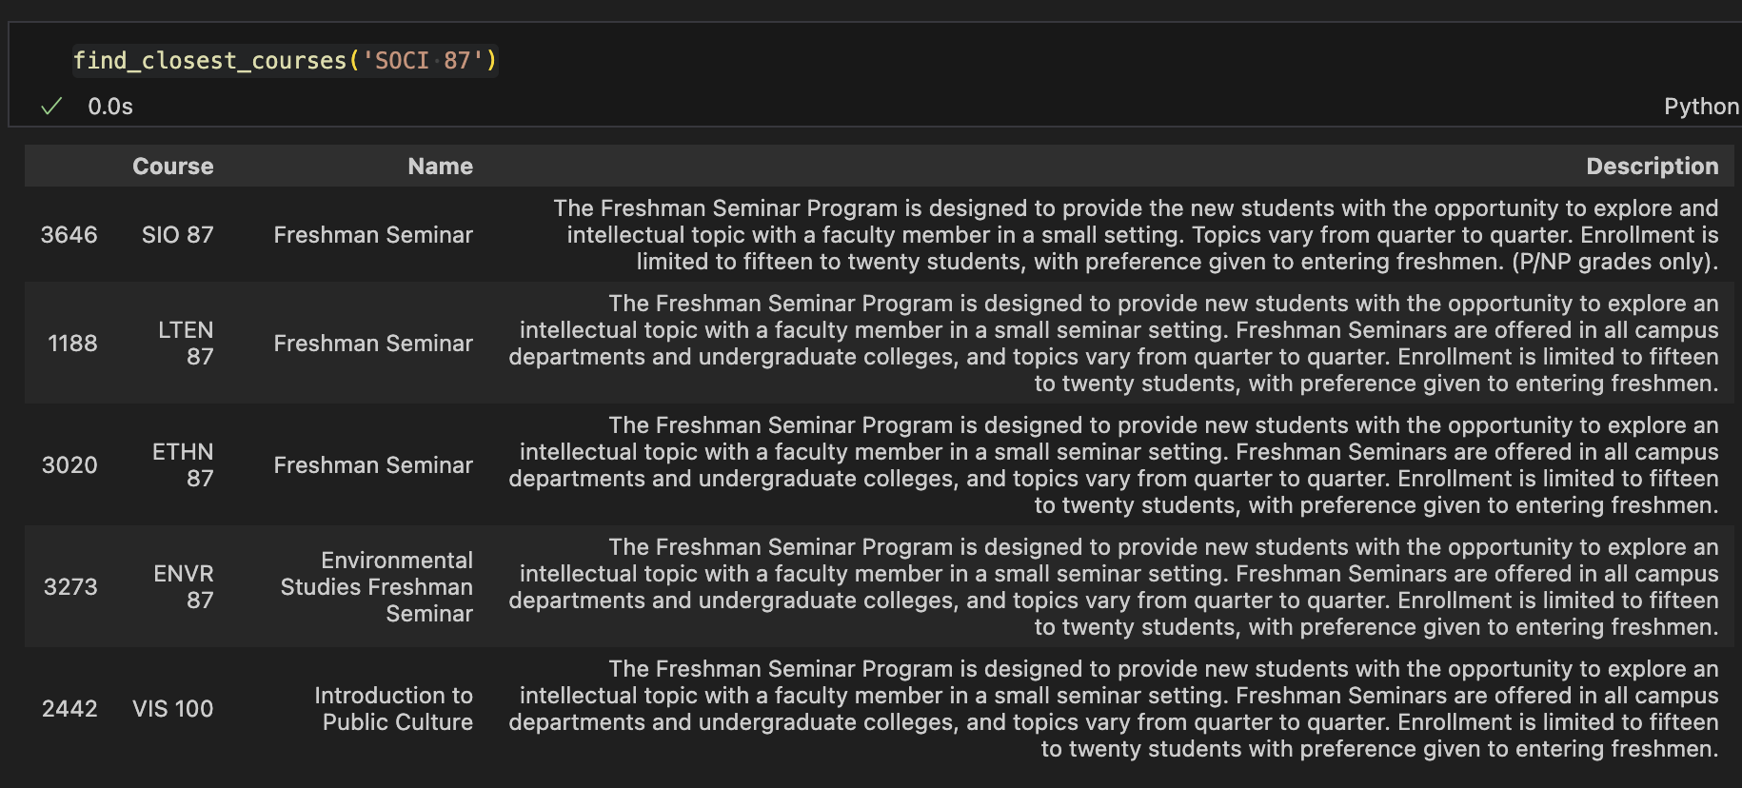
Check model prediction
t-TSNE K-Means insights
Cluster 0 topic,quarter,repeated,three,taken,times,credit,topics,may,vary

Slide 10
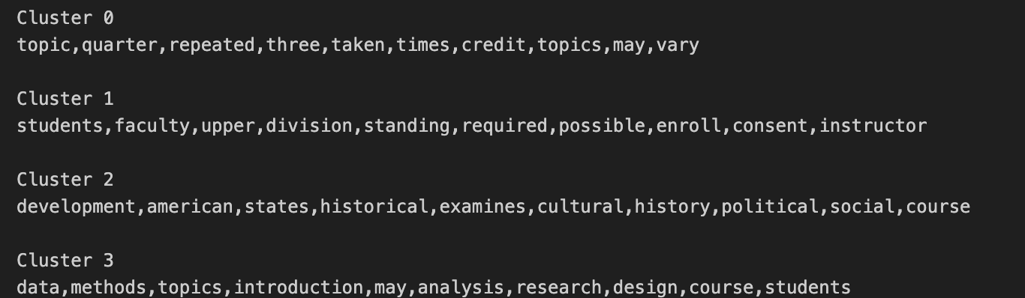
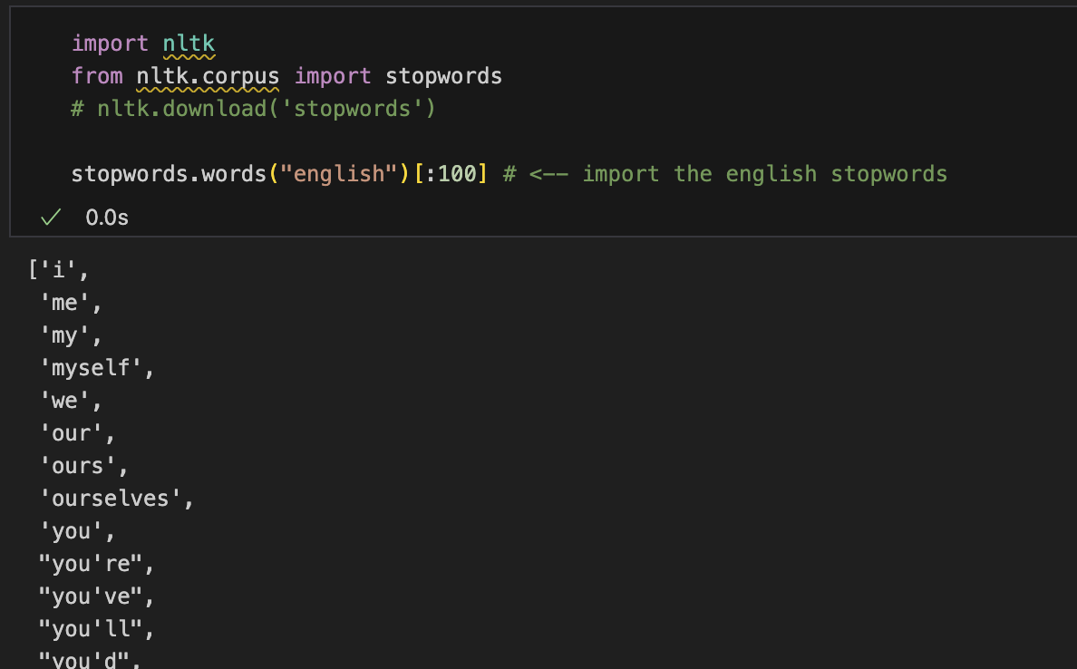
Takaways and todos
Removing more customized words during preprocessing, and see corresponding clustering results

Slide 11
Takaways and todos
Adding more input into the function:
  Whether not showing lower level coursese
  Whether same subjects
  Adjustments relating to term providing the courses
With current experience try different models, such as Word2Vec
Potential Web Scaping of current

