Slide 1
Atlas Meeting 14
Yihao Chen

Slide 2
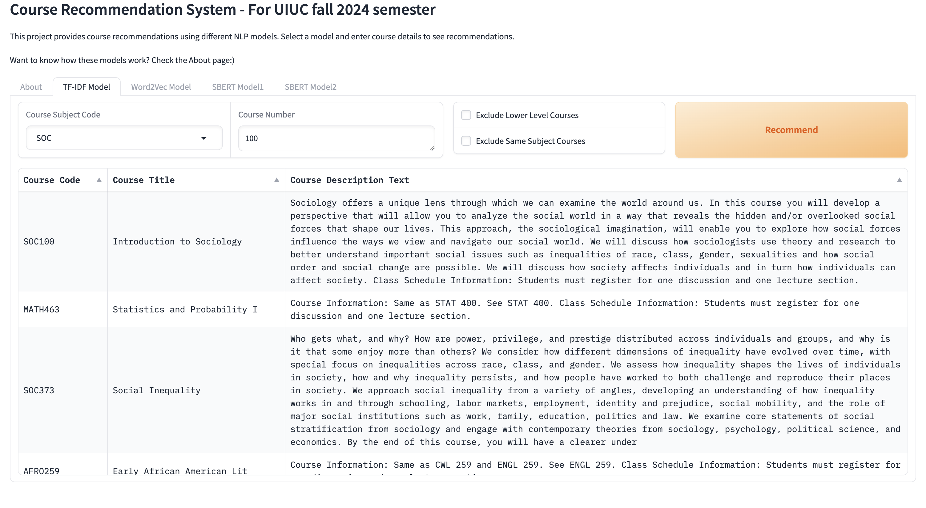
Gradio layout adjustment
Change from gr.interface() to gr.block().
http://127.0.0.1:7918

Slide 3
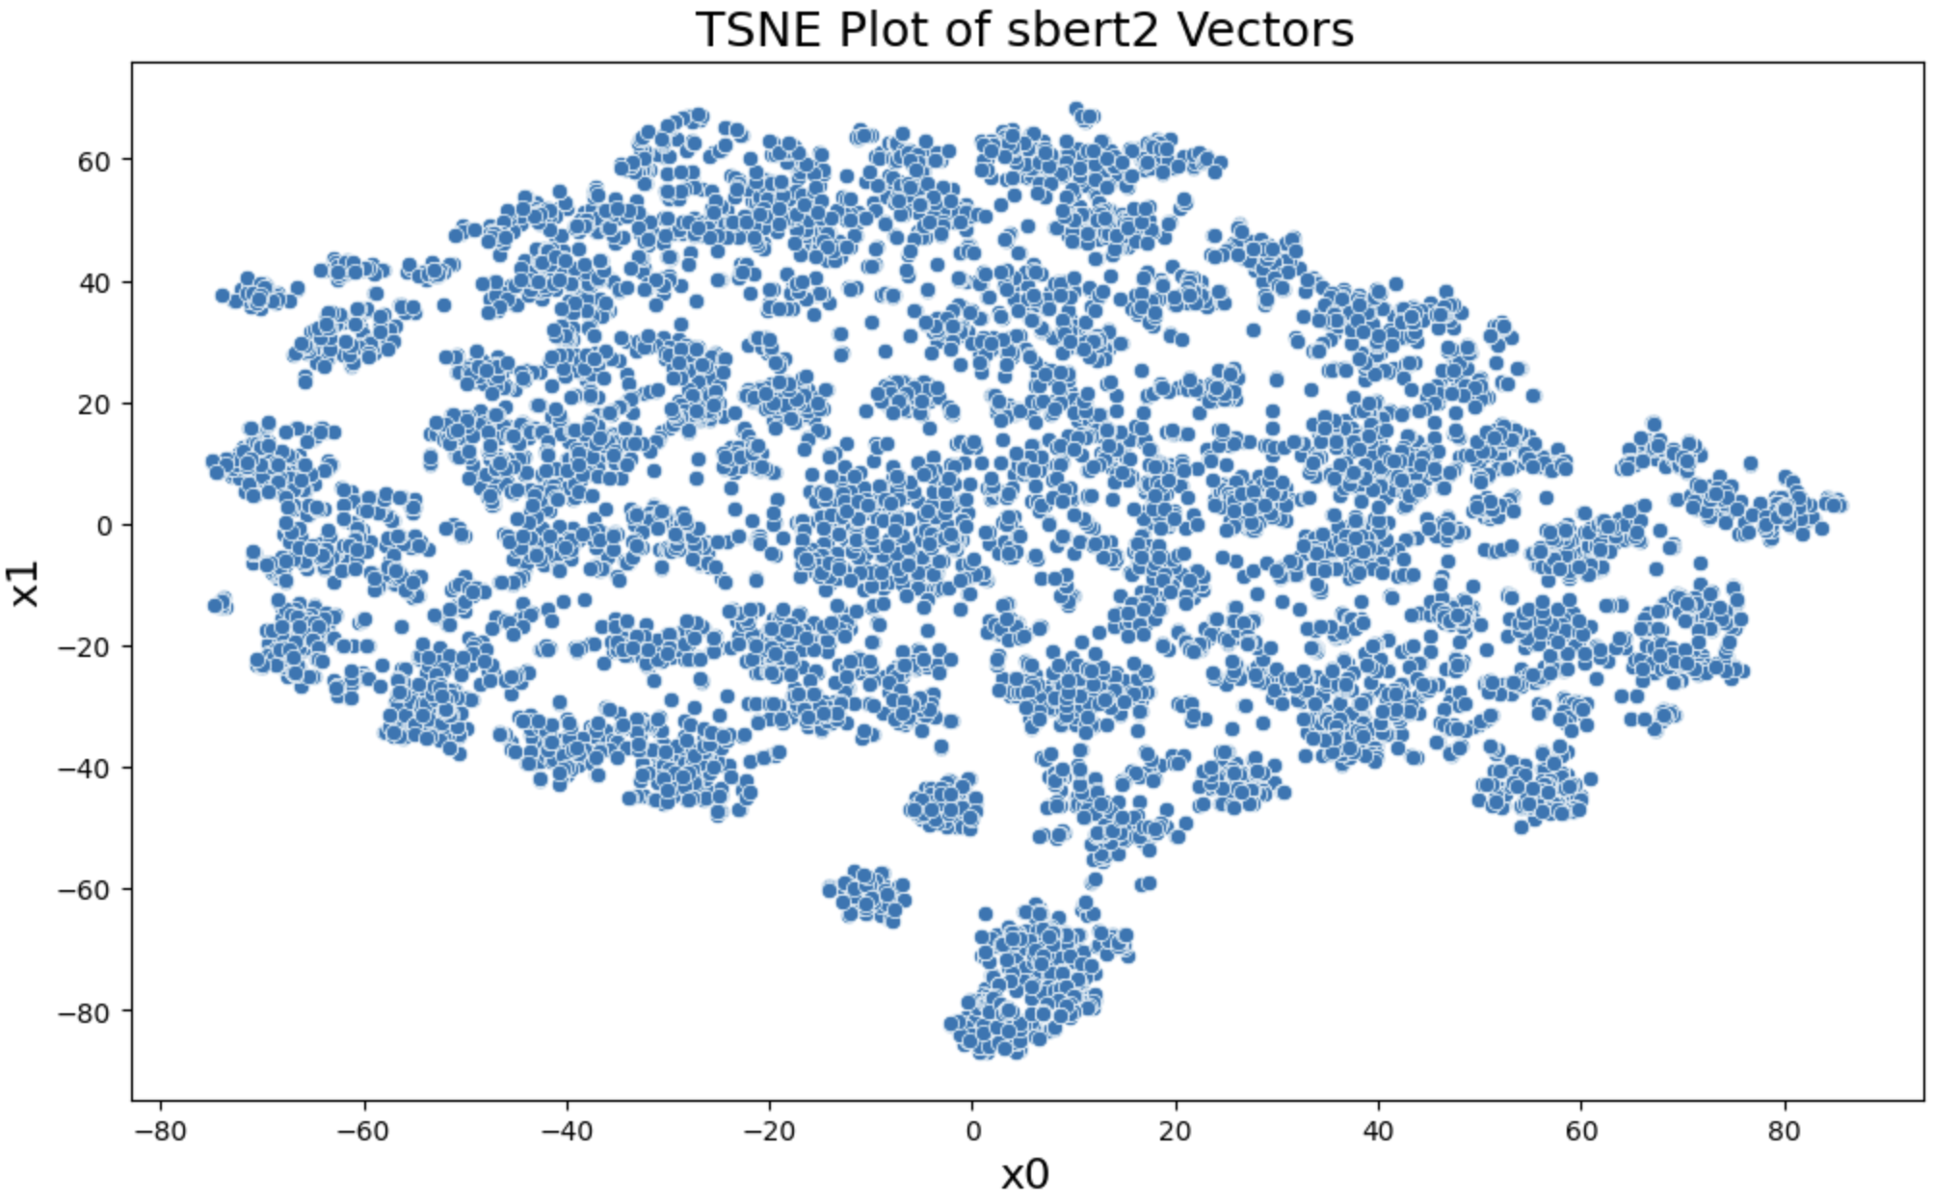
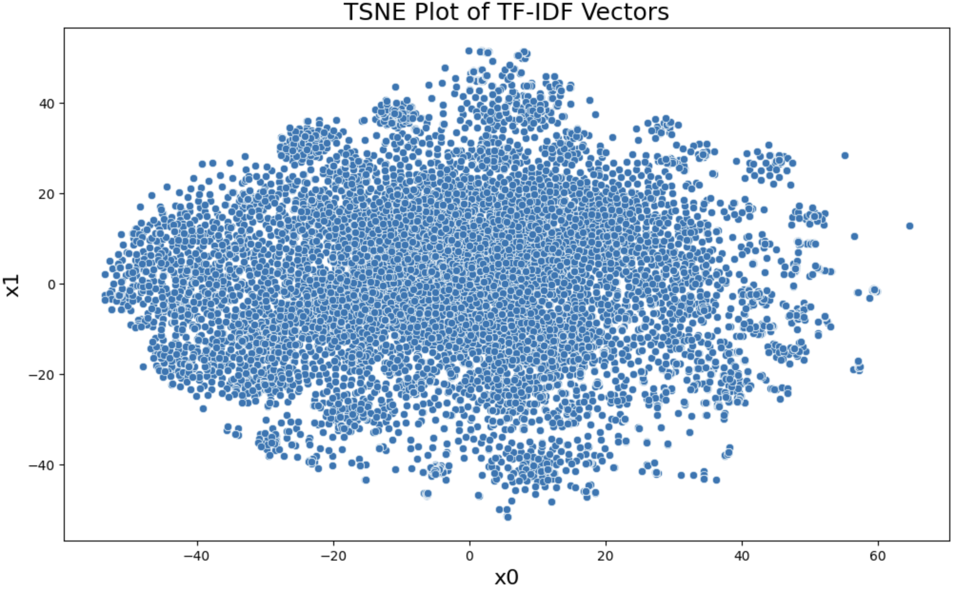
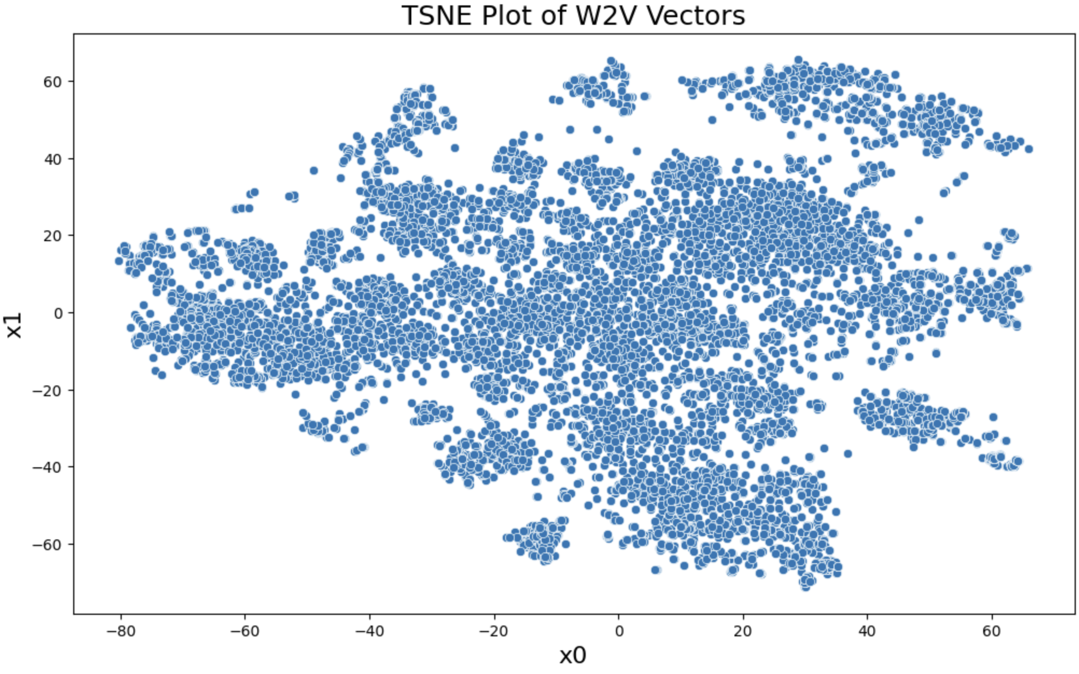
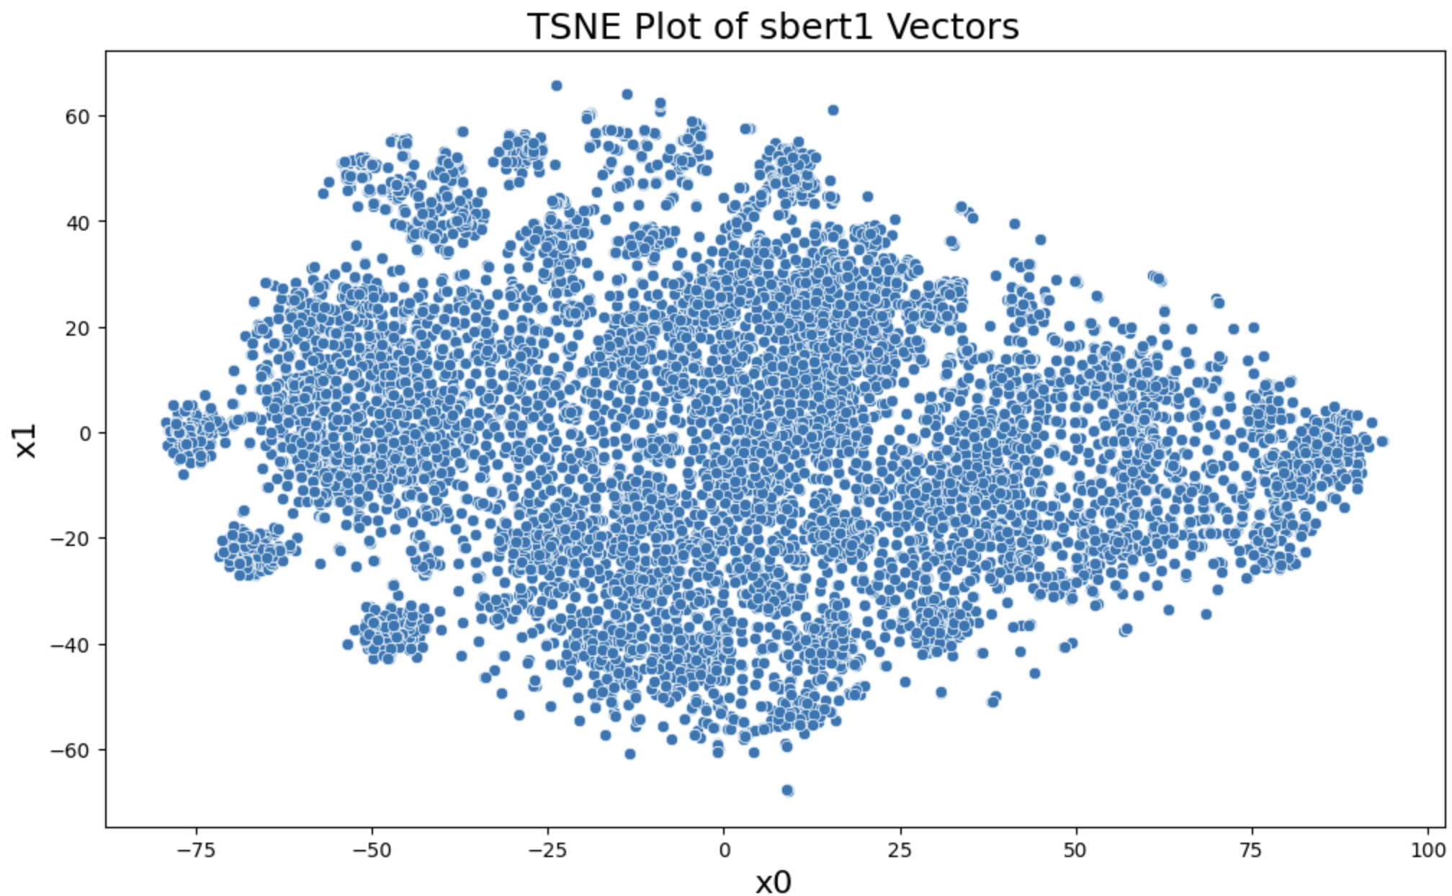
Todos
Adding scatterplot using gradio.ScatterPlot(···)
Finish about page.

