Slide 1
Atlas Meeting 12
Yihao Chen

Slide 2
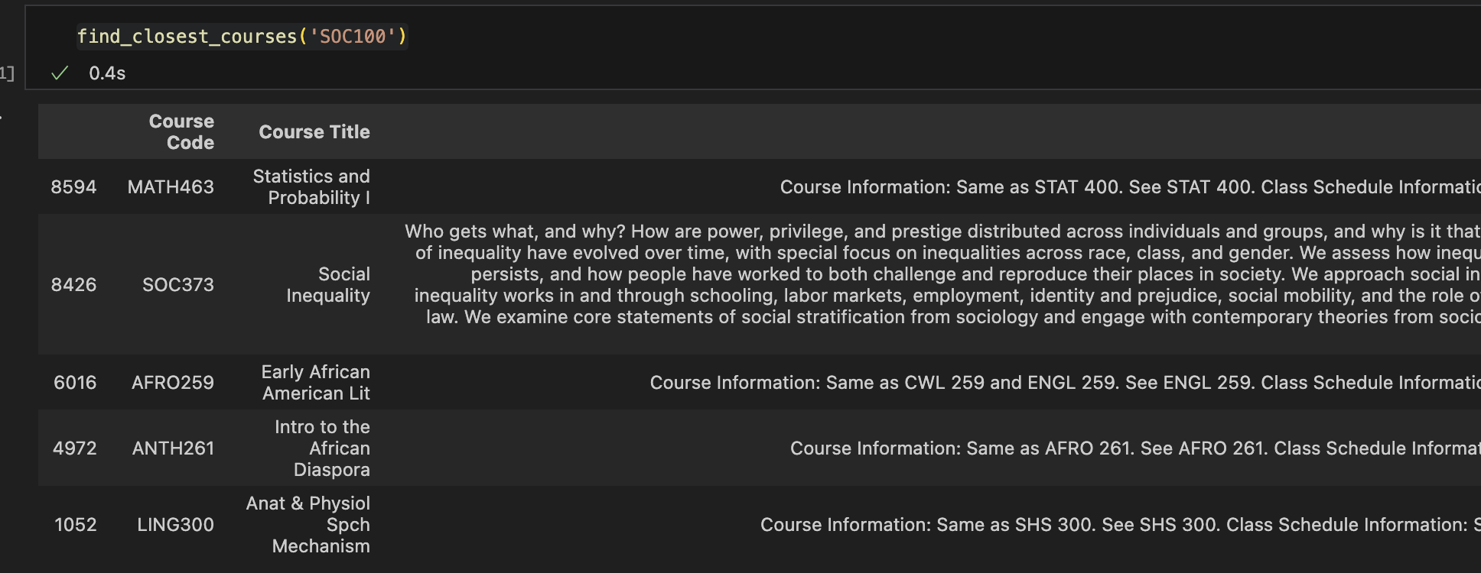
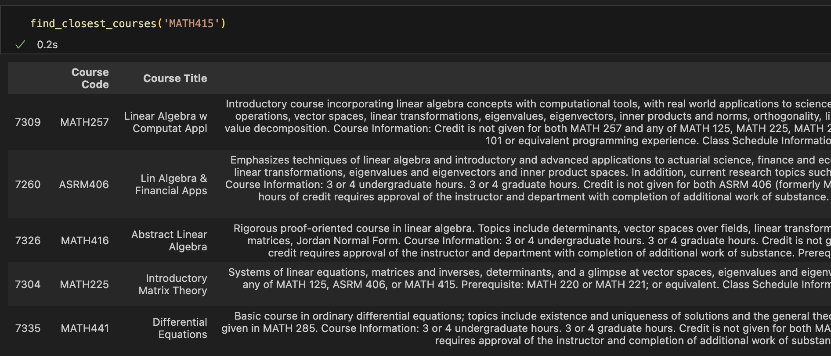
Try on 2024 fall data
Tf-idf

Slide 3
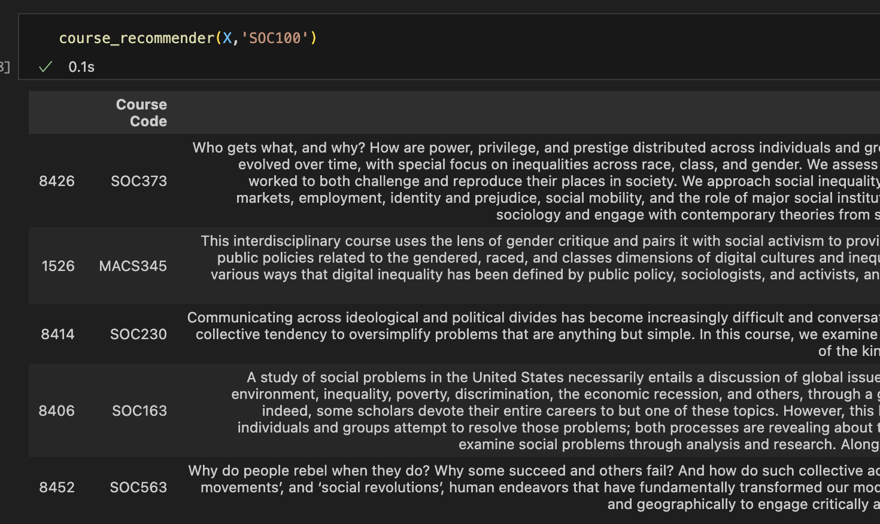
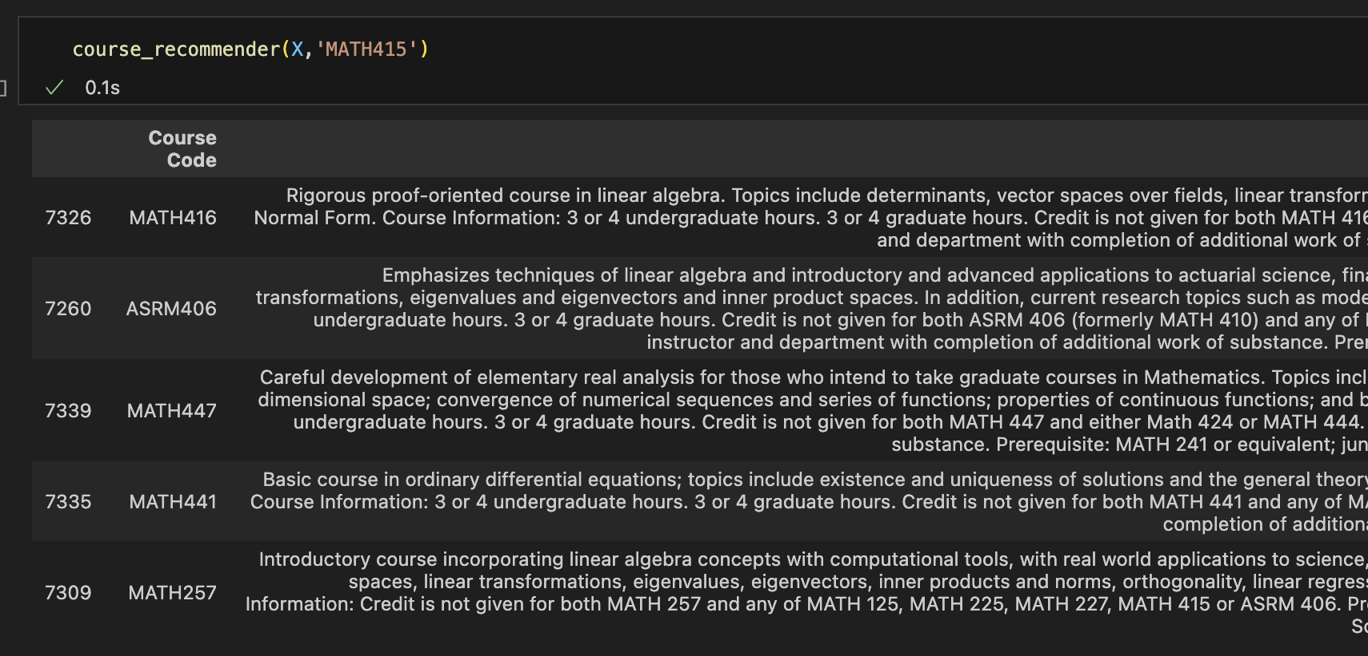
Try on 2024 fall data
Word2Vec

Slide 4
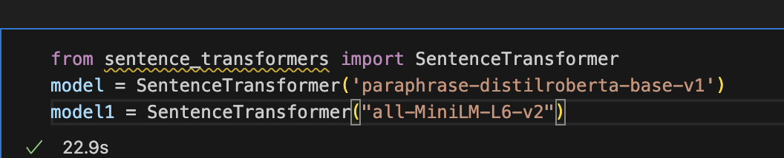
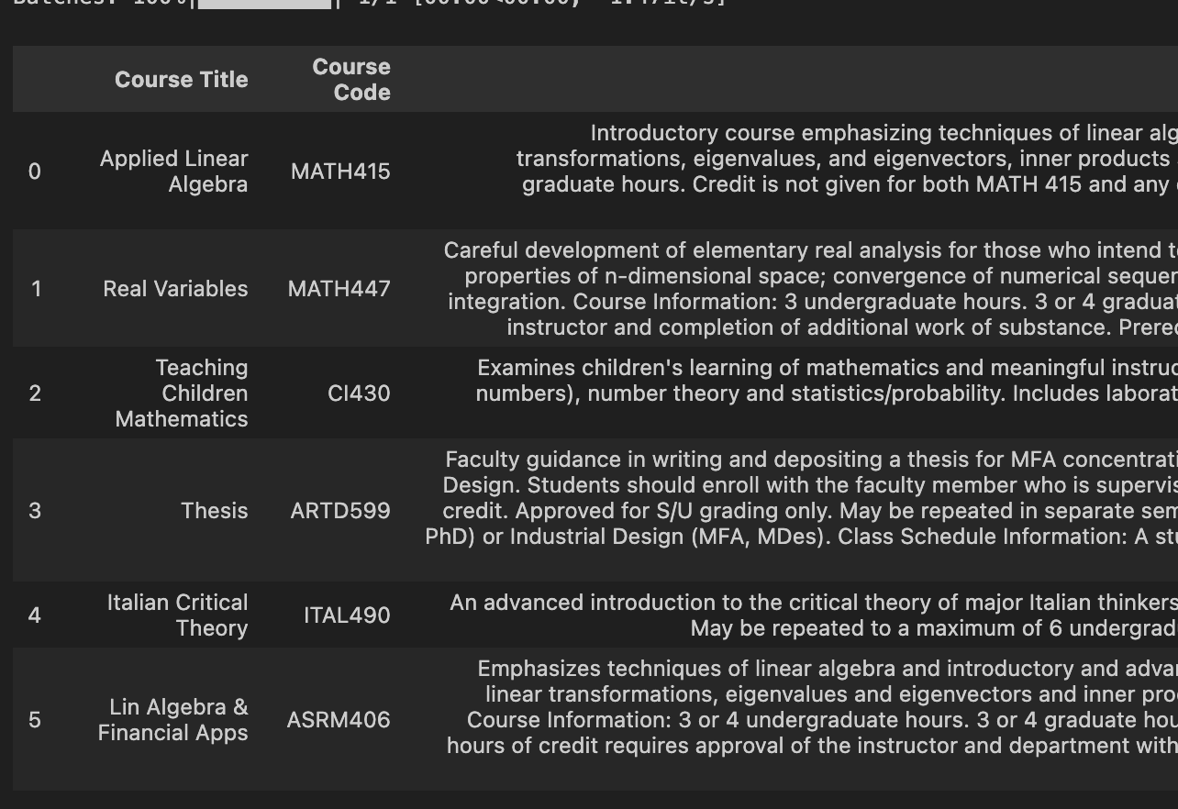
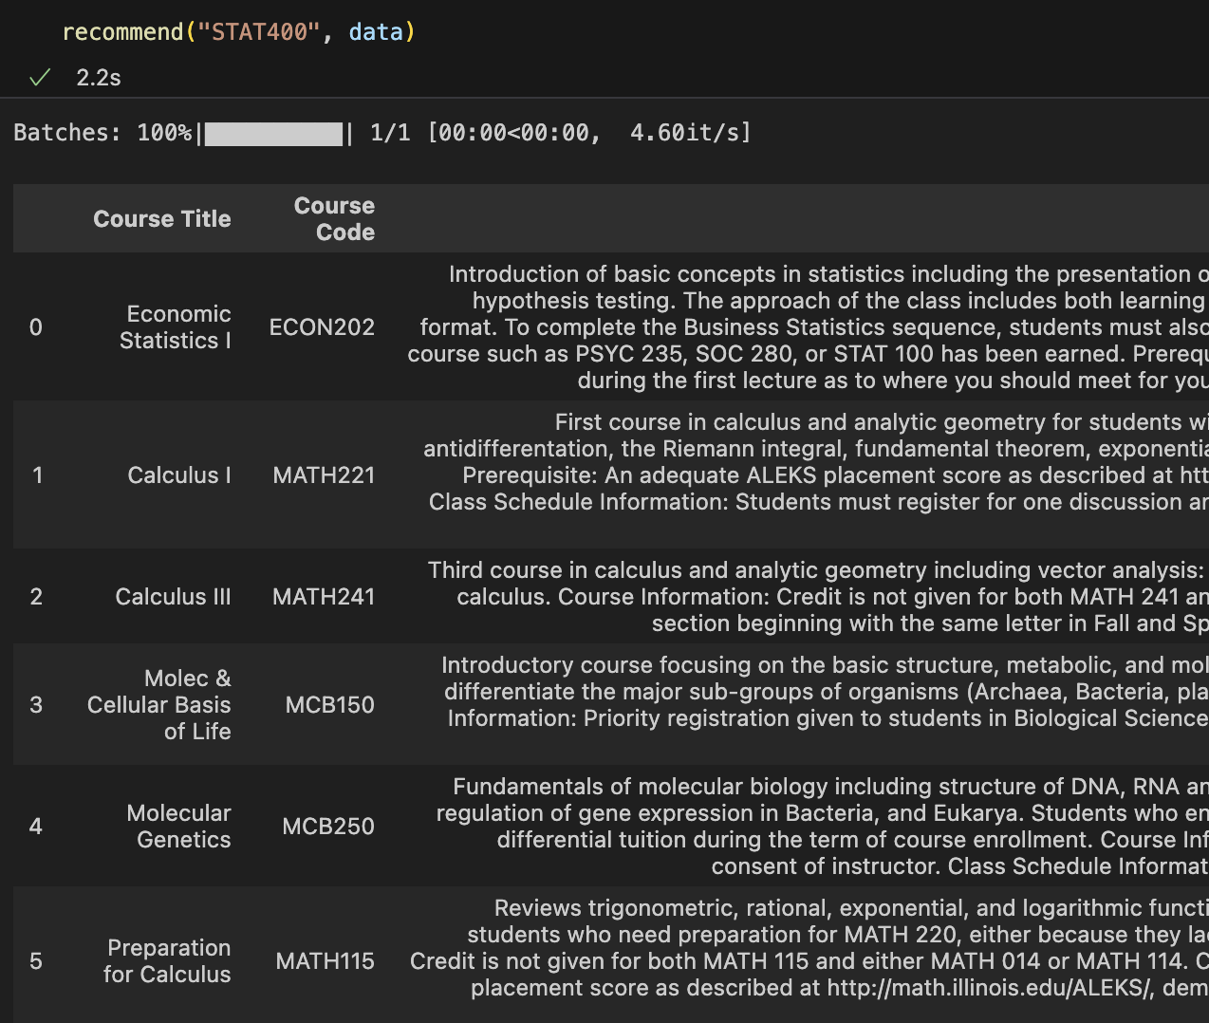
Try on 2024 fall data
SBert

Slide 5
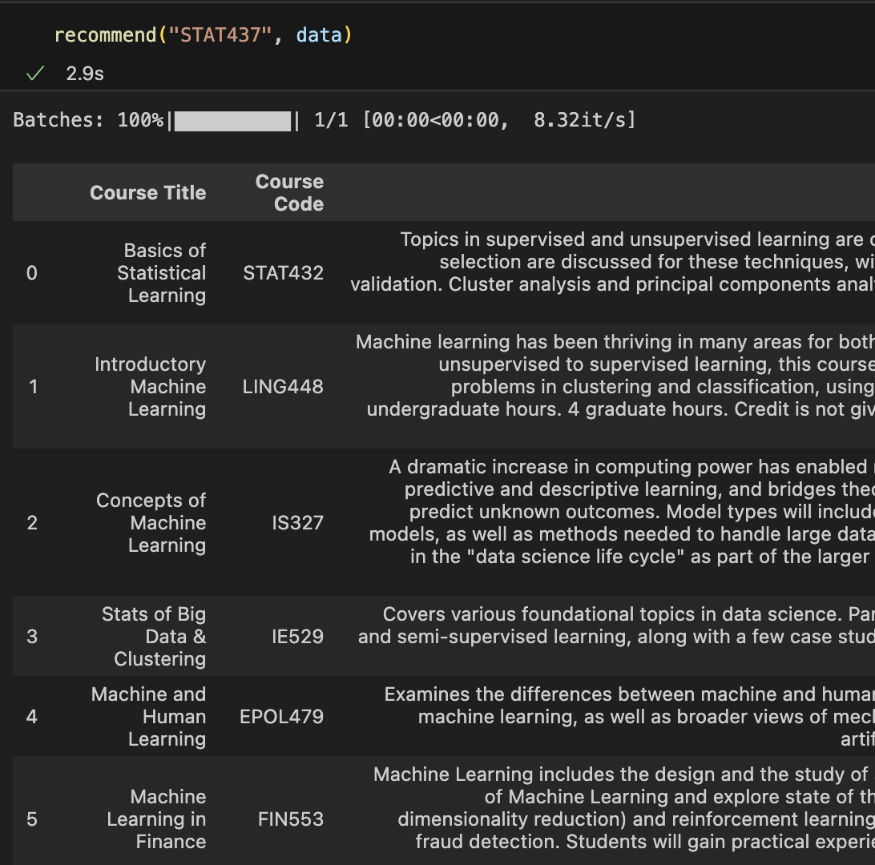
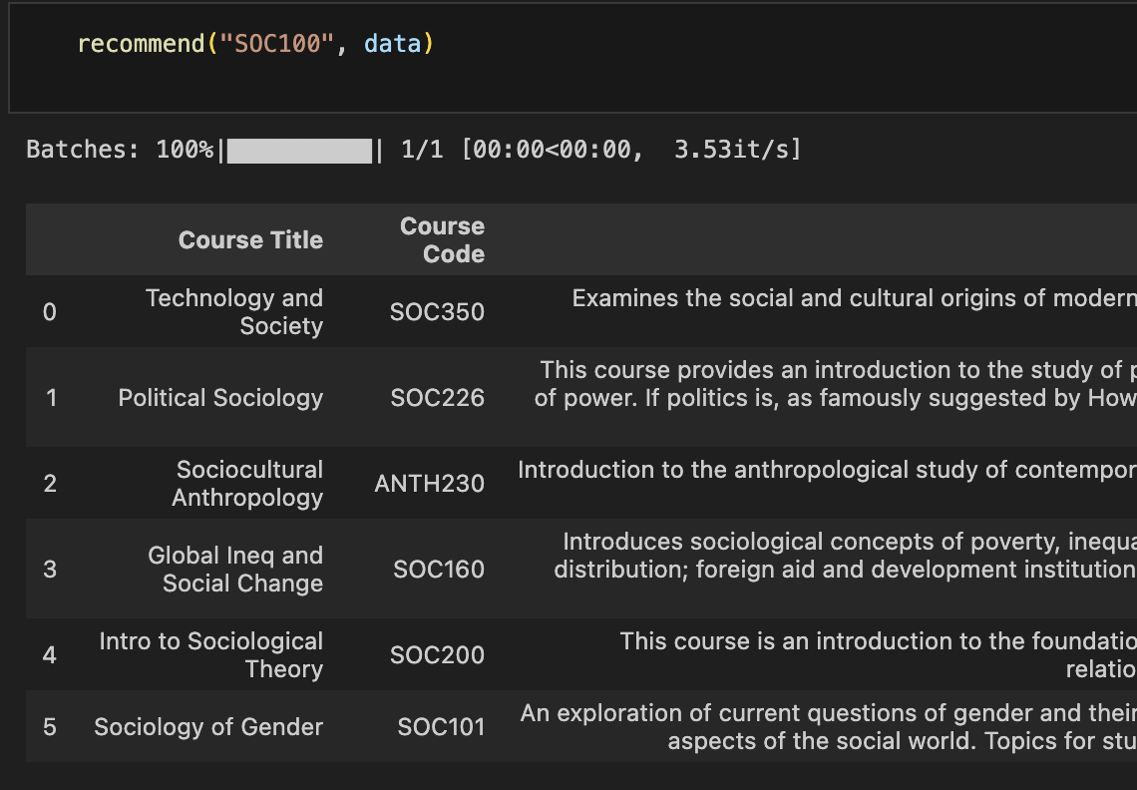
Try on 2024 fall data
SBert

Slide 6
Takaways and todos
Sentence wise algorithms works results in similar outputs.
Work on Gradio

