Slide 1
Atlas Meeting 11
Yihao Chen

Slide 2
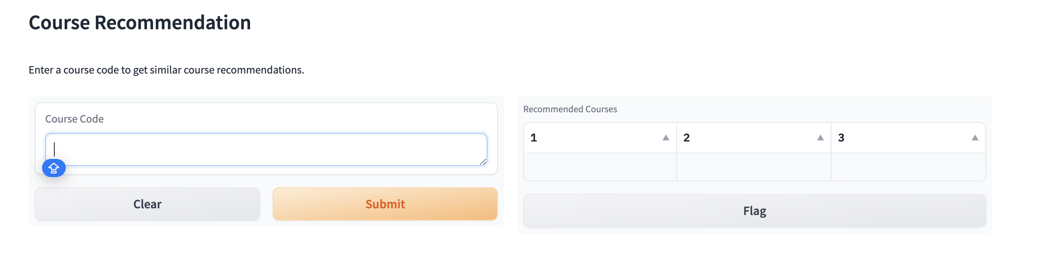
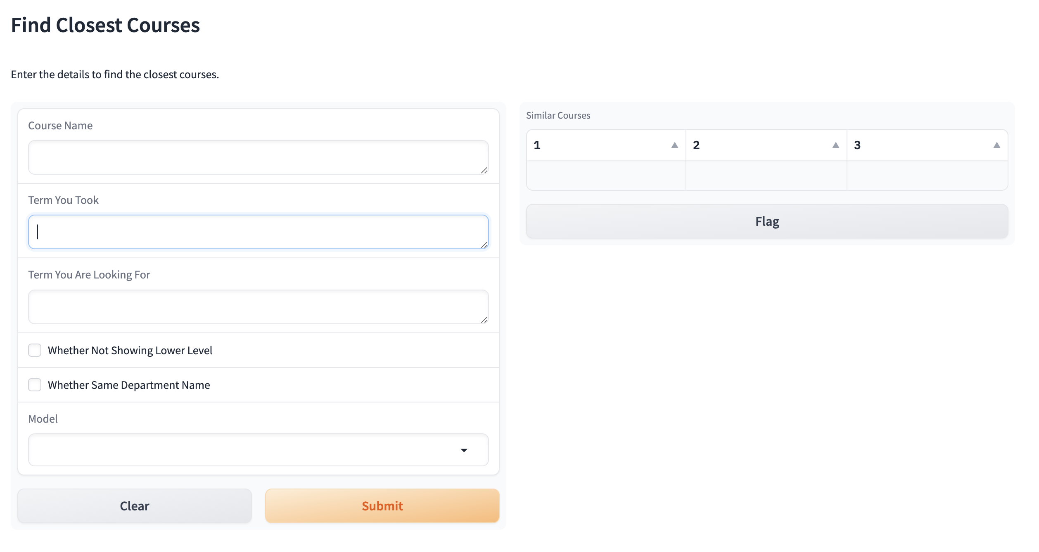
Overlook of Gradio

Slide 3
Takaways and todos
Complete dataset (50k rows), slow response time just to get the recommendations
  Focus only on one semester, “Spring 2024”
Complete the final recommendation building
  Filtering departments, prerequisites, level
  An intergraded function being able to select different models
Visualizations of different models for presentation.

