Slide 1
Atlas Meeting 10
Yihao Chen

Slide 2
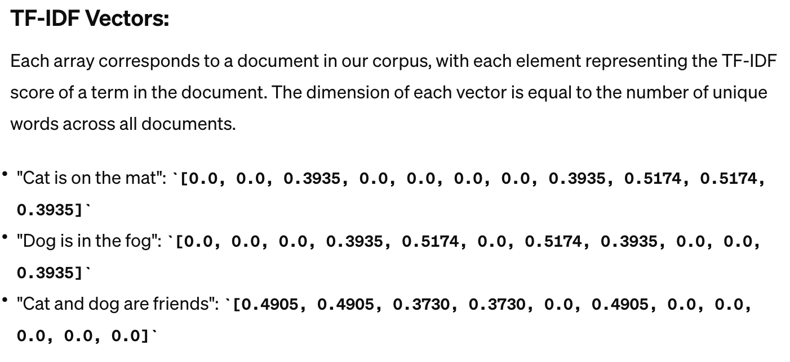
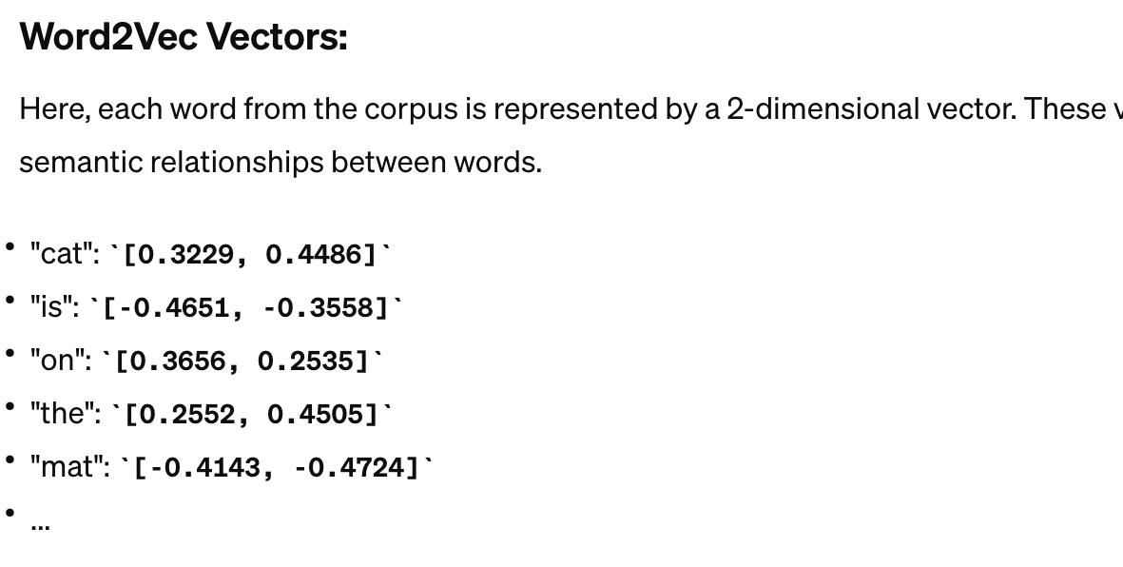
Machine learning model
TF-IDF vector
  More direct representation in documents level
Word2Vec
Sentence transformer

Slide 3
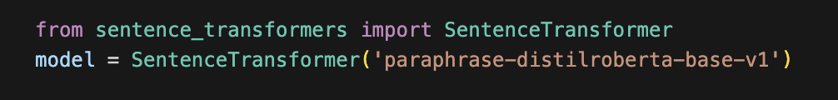
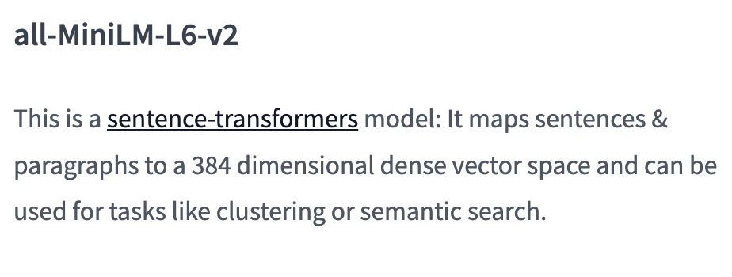
Machine learning model
TF-IDF vector
  More direct representation in documents level
Word2Vec
Sentence transformer
  all-MiniLM-L6-v2
  Also direct representation in documents level

Slide 4
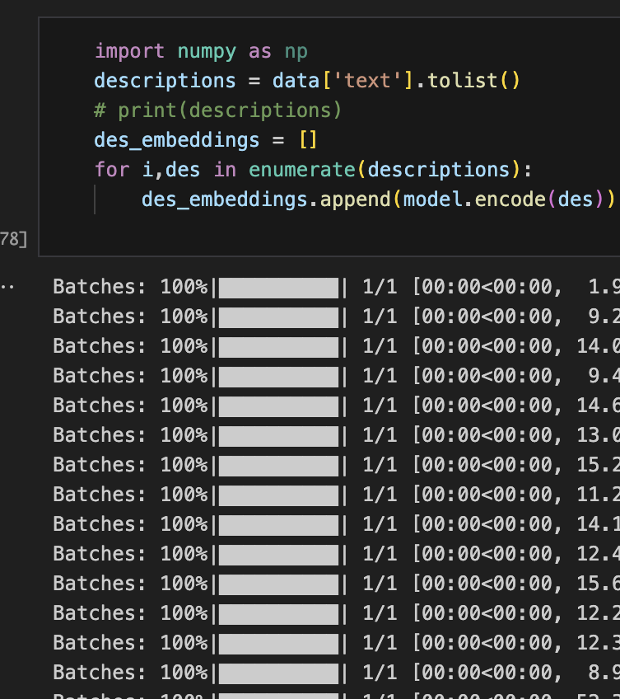
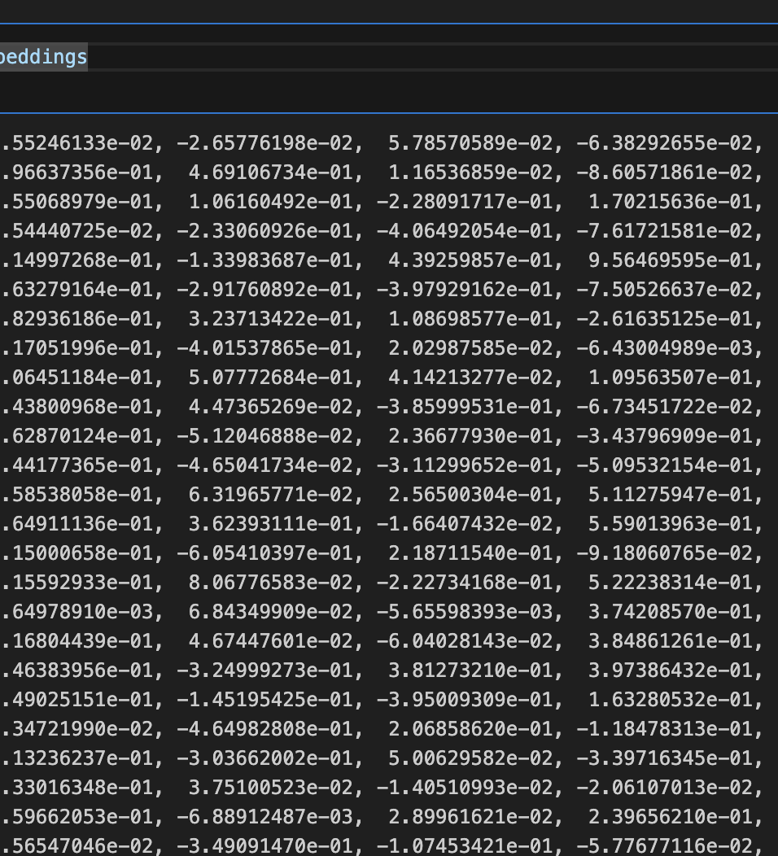
Machine
Sentence transformer
  No need to preprocessing the description data
  Time consuming when training the model

Slide 5
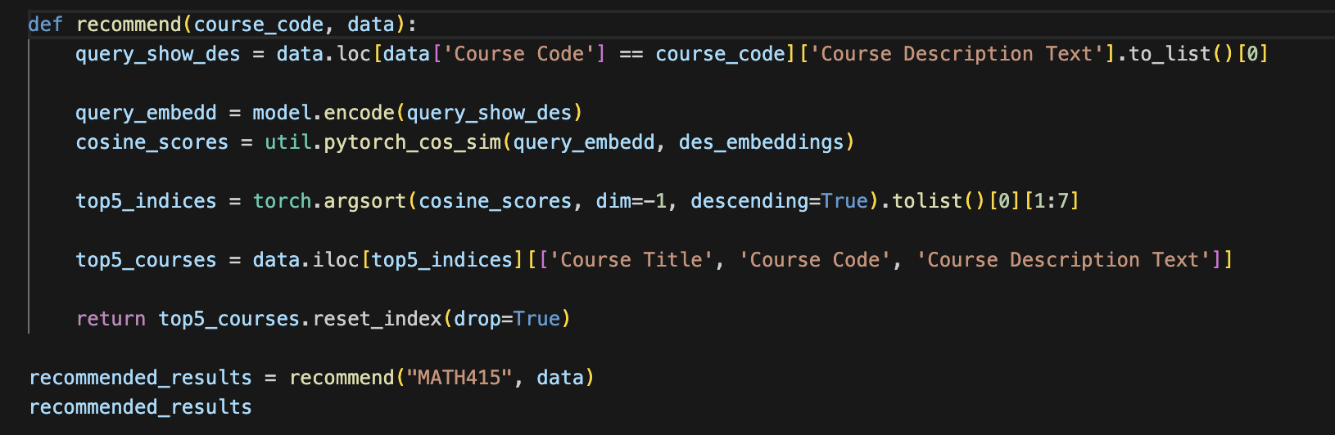
Machine
Sentence transformer
  No need to preprocessing the description data
  Time consuming when training the model
  Recommendation results:
      Using prebuilt encode, function

Slide 6
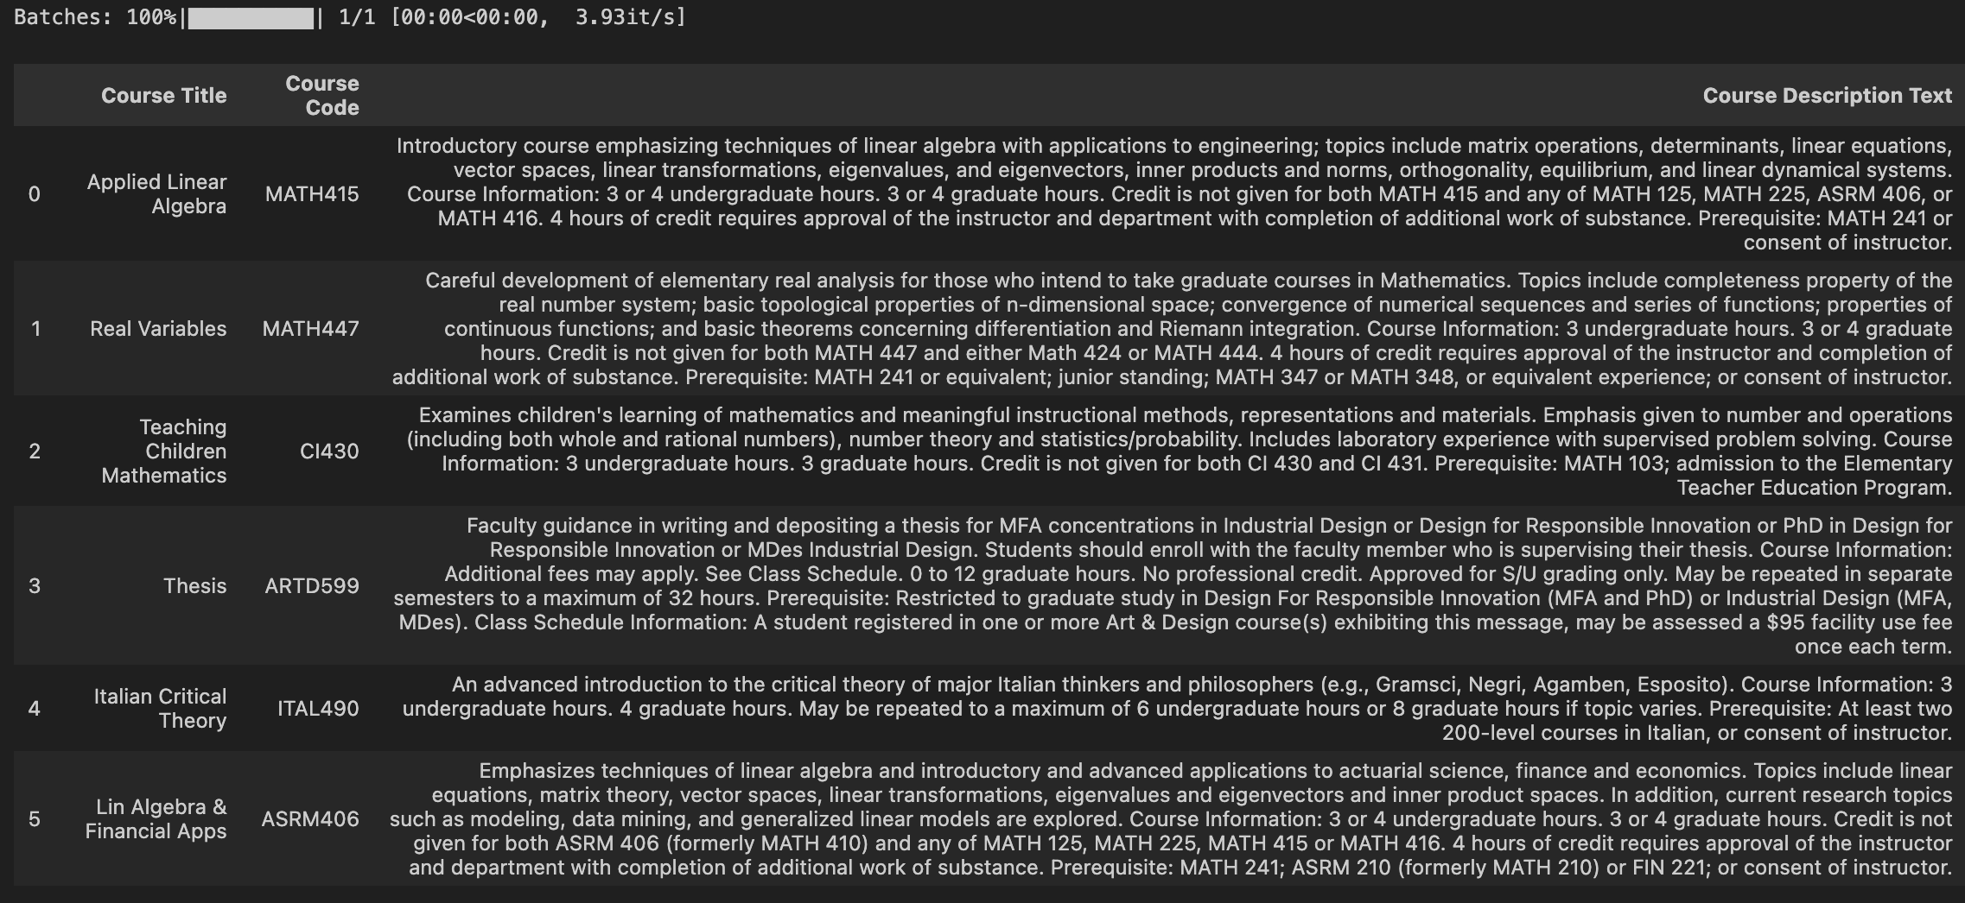
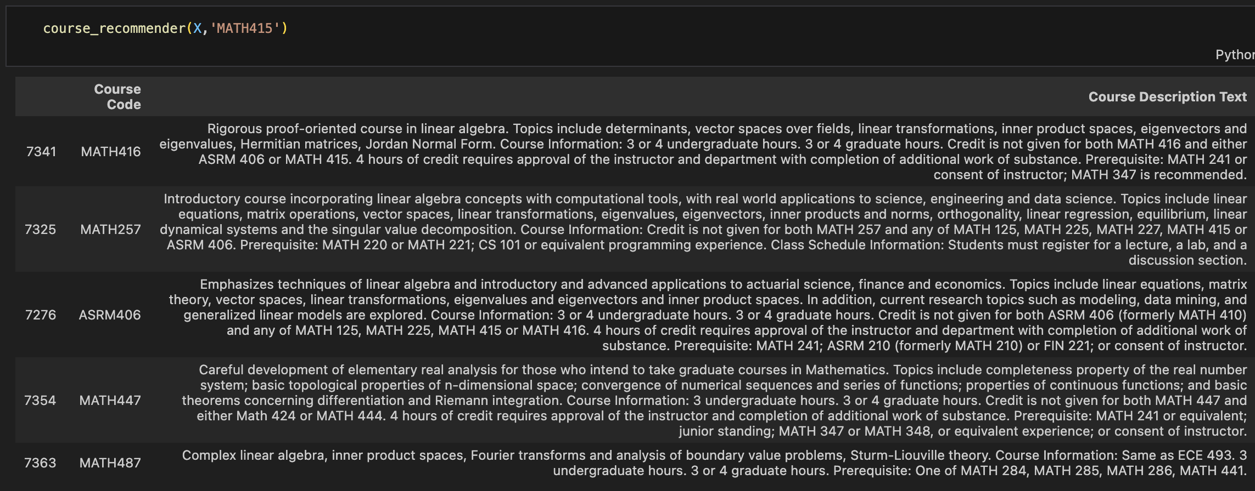
Machine
Sentence transformer
  No need to preprocessing the description data
  Time consuming when training the model
  Recommendation results:
      Using prebuilt encode function
Results of sentence transformer
Results of word 2 vec

Slide 7
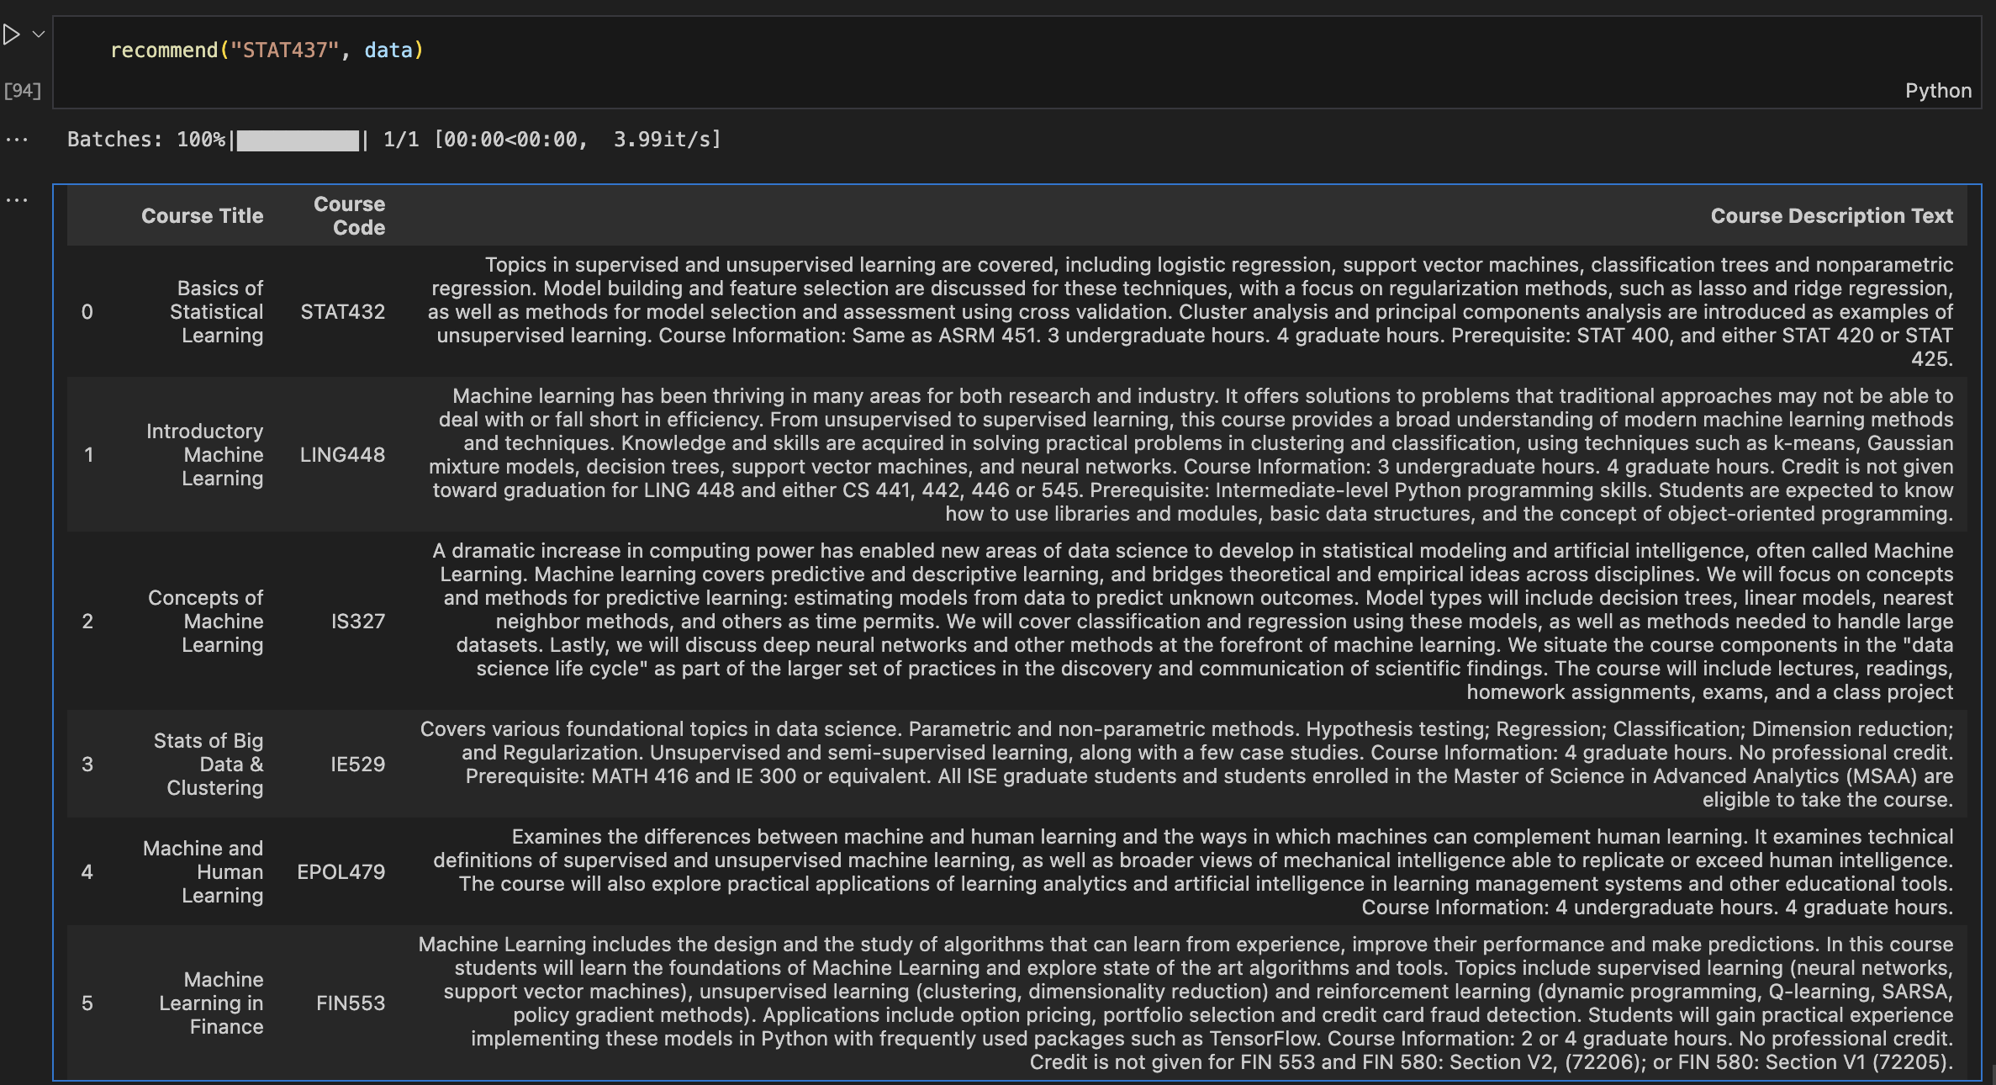
Machine
Sentence transformer
  No need to preprocessing the description data
  Time consuming when training the model
  Recommendation results:
      Using prebuilt encode function

Slide 8

Machine
Sentence transformer
  No need to preprocessing the description data
  Time consuming when training the model
  Recommendation results:
      Using prebuilt encode function

Slide 9
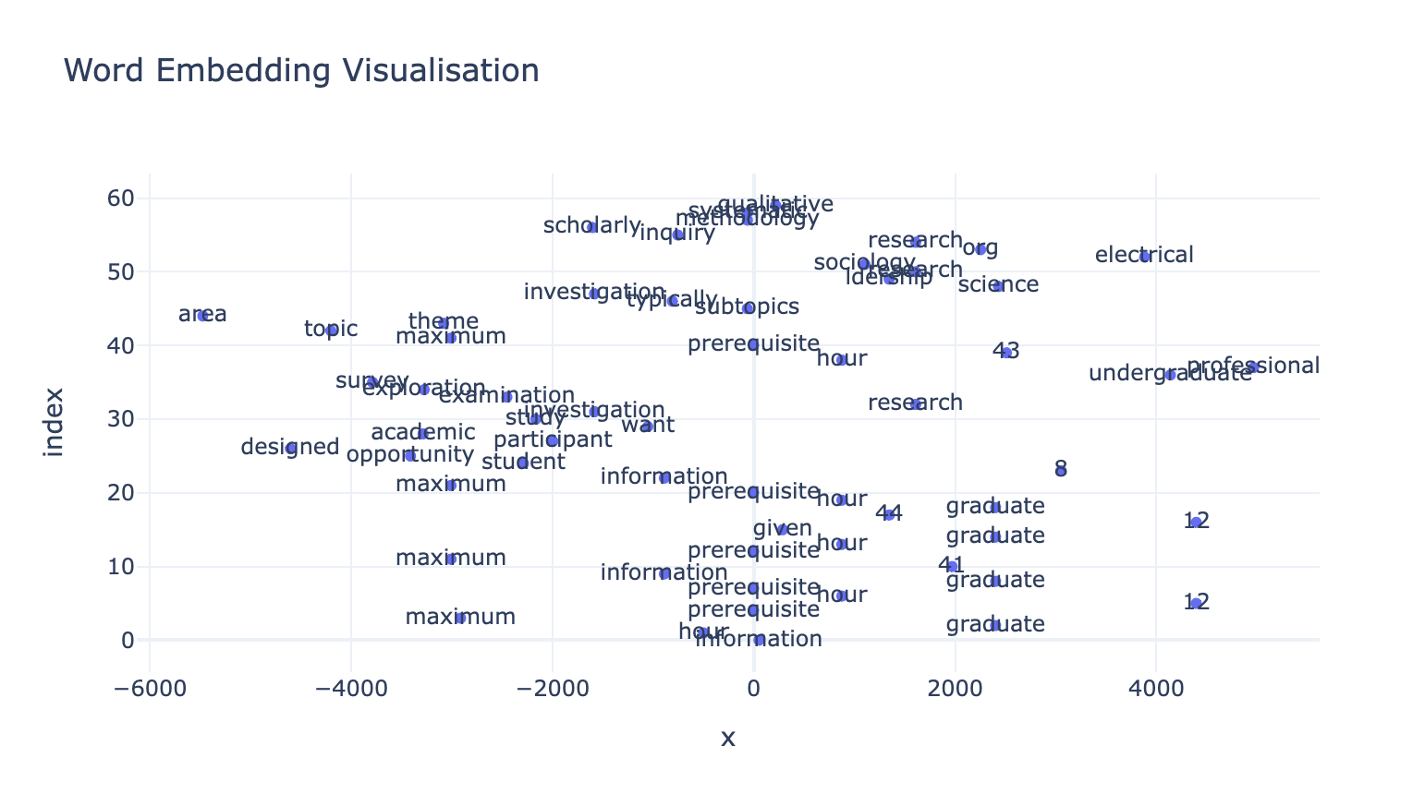
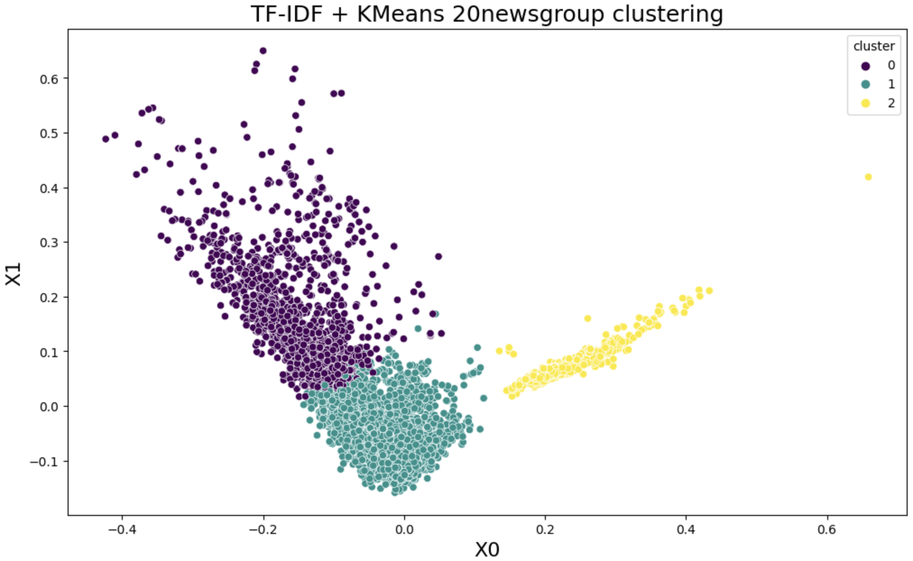
Takaways and todos
Visualization for Word2Vec
Visualization for Sentence transformer
  Potentially something similar to tf-idf
Work on larger dataset
Compare different models
Complete the final recommendation building
  Filtering departments, prerequisites, level
  An intergraded function being able to select different models

