Slide 1
Atlas Machine learning Project A course recommendation system
Yihao Chen
Senior, Statistics & Sociology

Slide 2
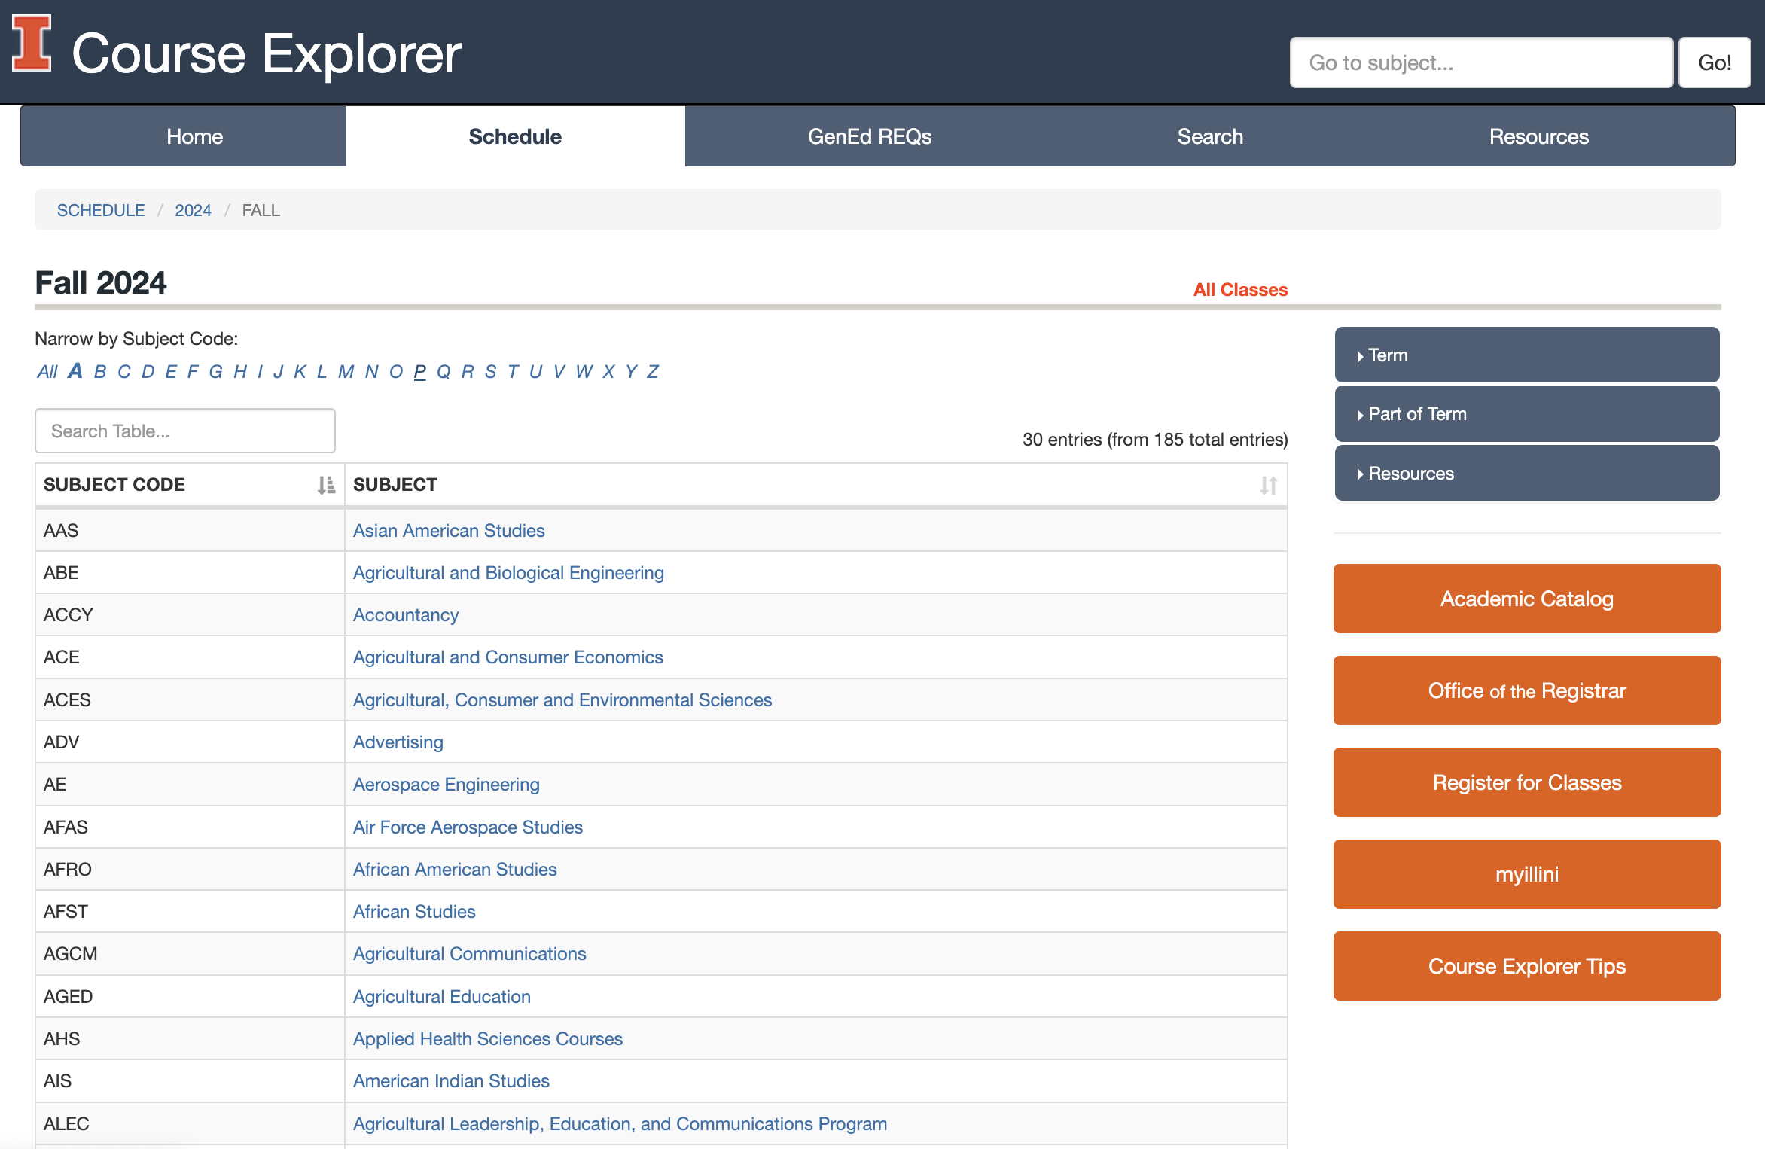
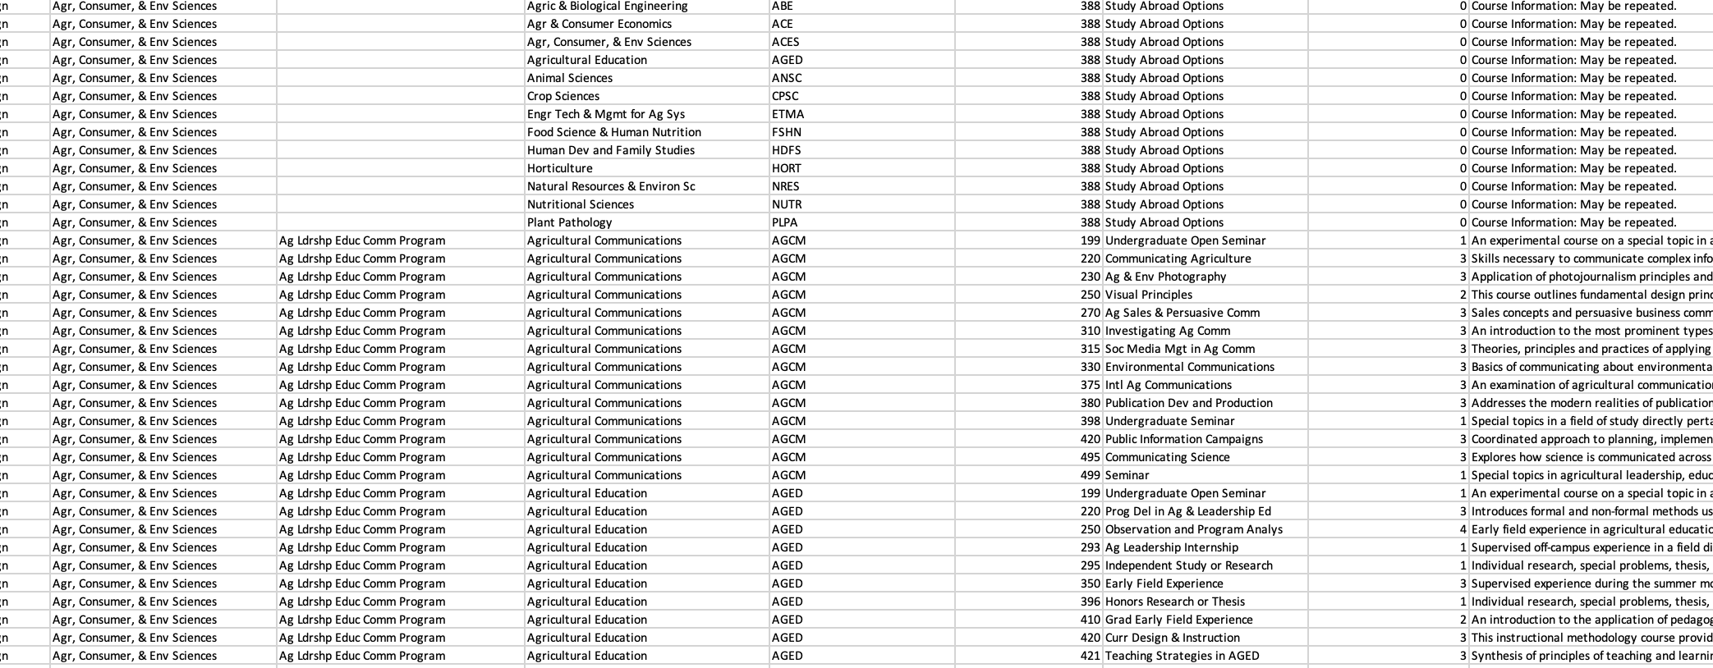
Dataset
UIUC Course Description for Fall 2024

Slide 3
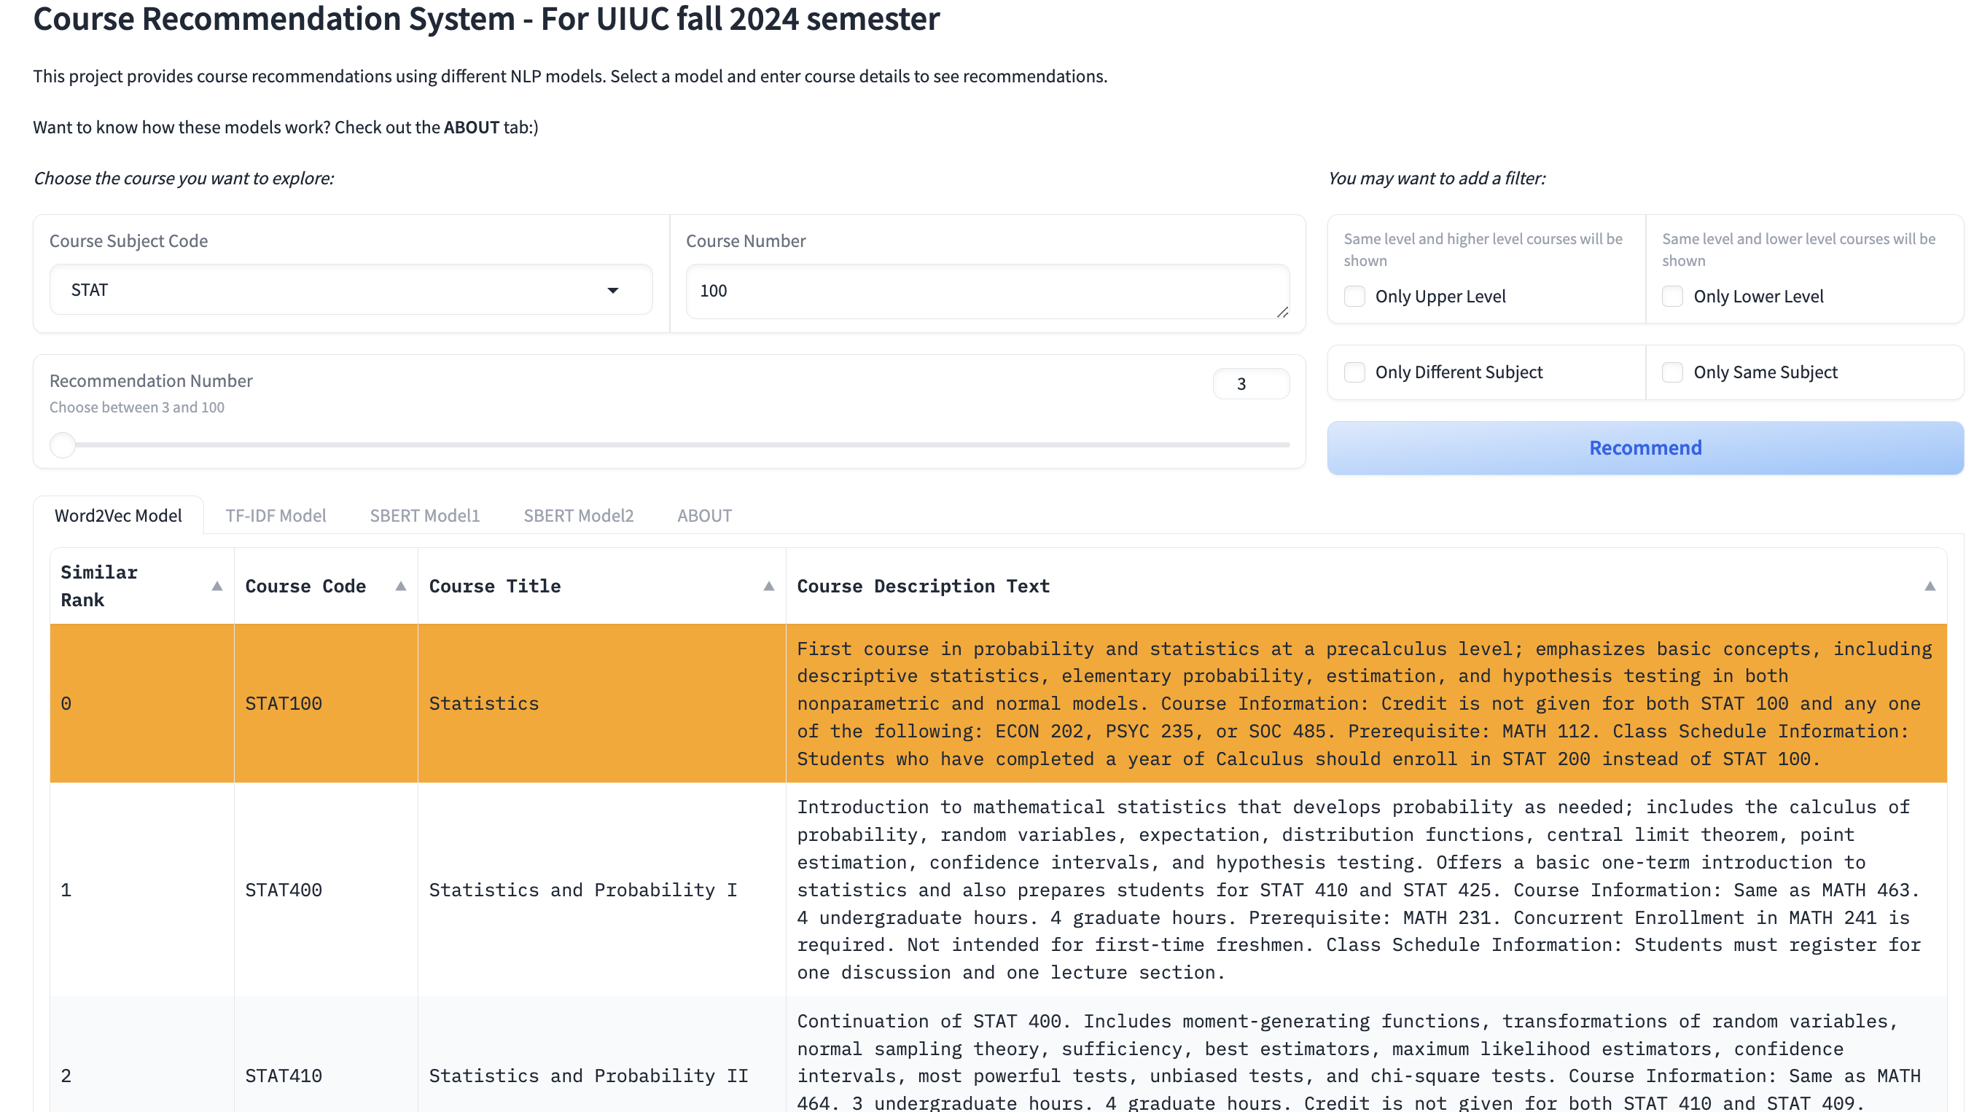
Course recommendation Goal
A course recommendation tool: input the one course and return several other similar courses.
A small tool to help students, providing some general insights
Multi-subject recommendation: “Machine learning” - Stat, Math, CS, IS
It allows filtering:
Whether same subject as input
Upper level or not
Condition: excluding those courses that are prerequisites of the input course.

Slide 4
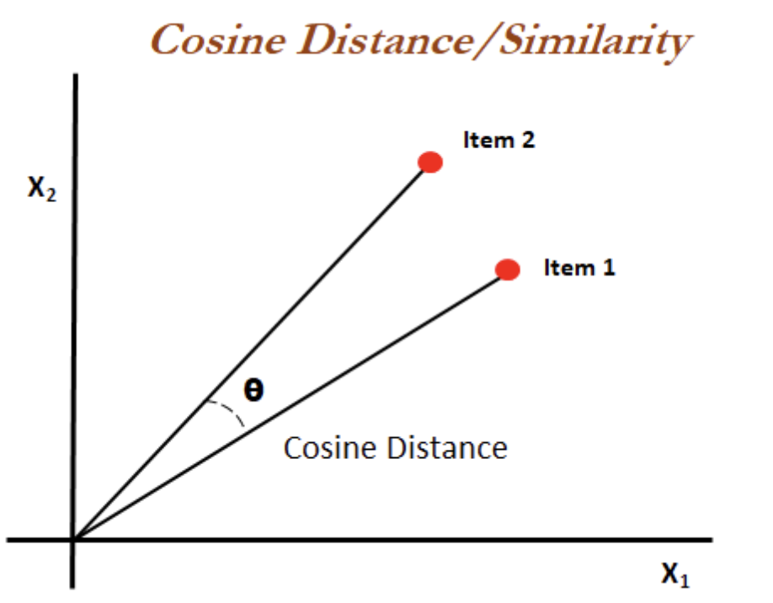
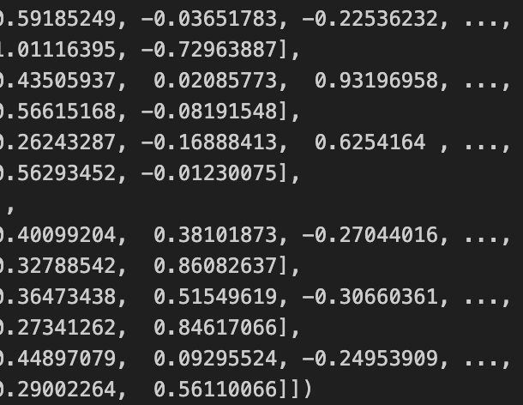
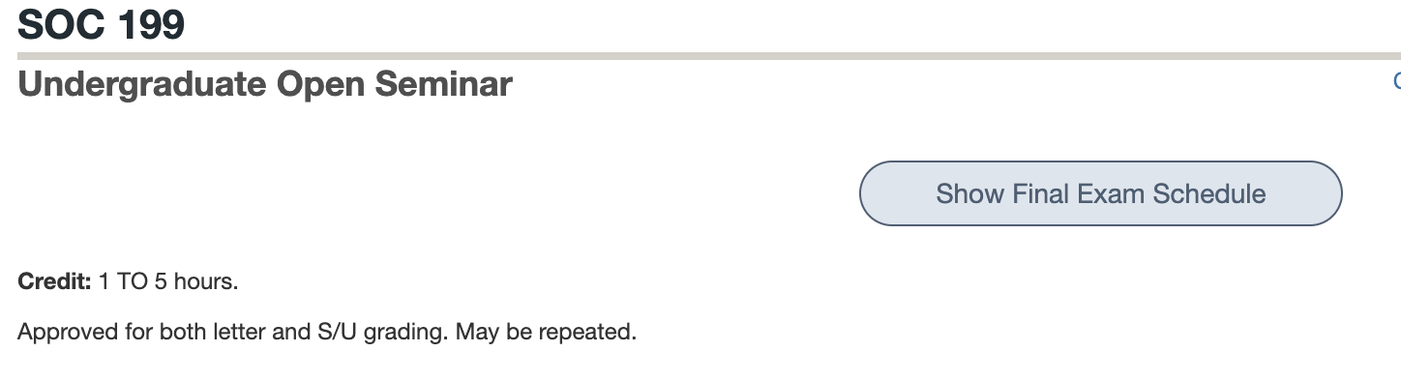
Method
Key ideas:
Vectorizing course descriptions
Compare cosine similarity between different courses to get the most similar courses.
Preprocessing:
Excluding courses with very general description:
Excluding common meaningless stopwords, such as “the”, “you”, “courses”, “students”
Applying NLP models to vectorize each course description.

Slide 5
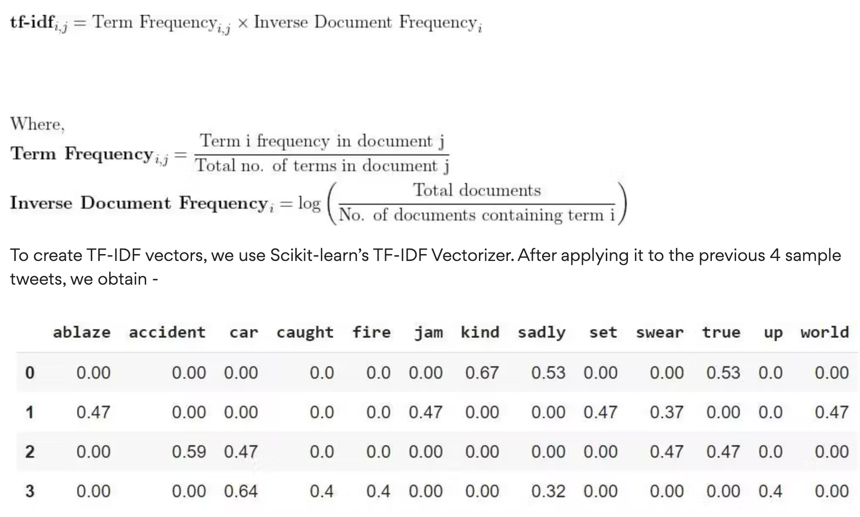
NLP algorithms 1 TF-IDF
TF-IDF matrix (9238, 5220)
Each row as each identical vector for course description
Each column represents one vocabulary being selected in the model

Slide 6
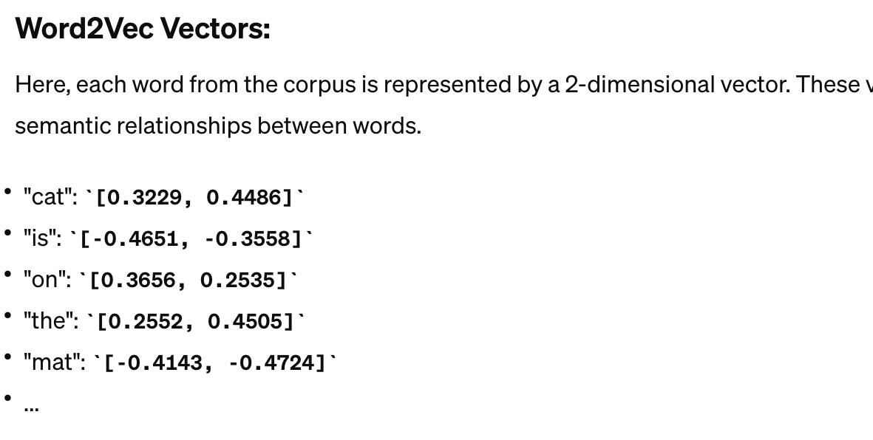
NLP algorithms II Word2vec
Word2Vec matrix (9238, 5220)
Build vocabulary set of 3940355 words.
Word vectors: 100 dimensions
Take the average of all the word vectors in a course description.
Matrix of (9238, 100)

Slide 7

NLP algorithms Pretrained lLM
Sentence transformer package
Pretrained models – direct document level of matrix with each row represents a vector of a course description document.
paraphrase-distilroberta-base-v1 (9238, 768)
all-mpnet-base-v2 (9238, 768)

Slide 8
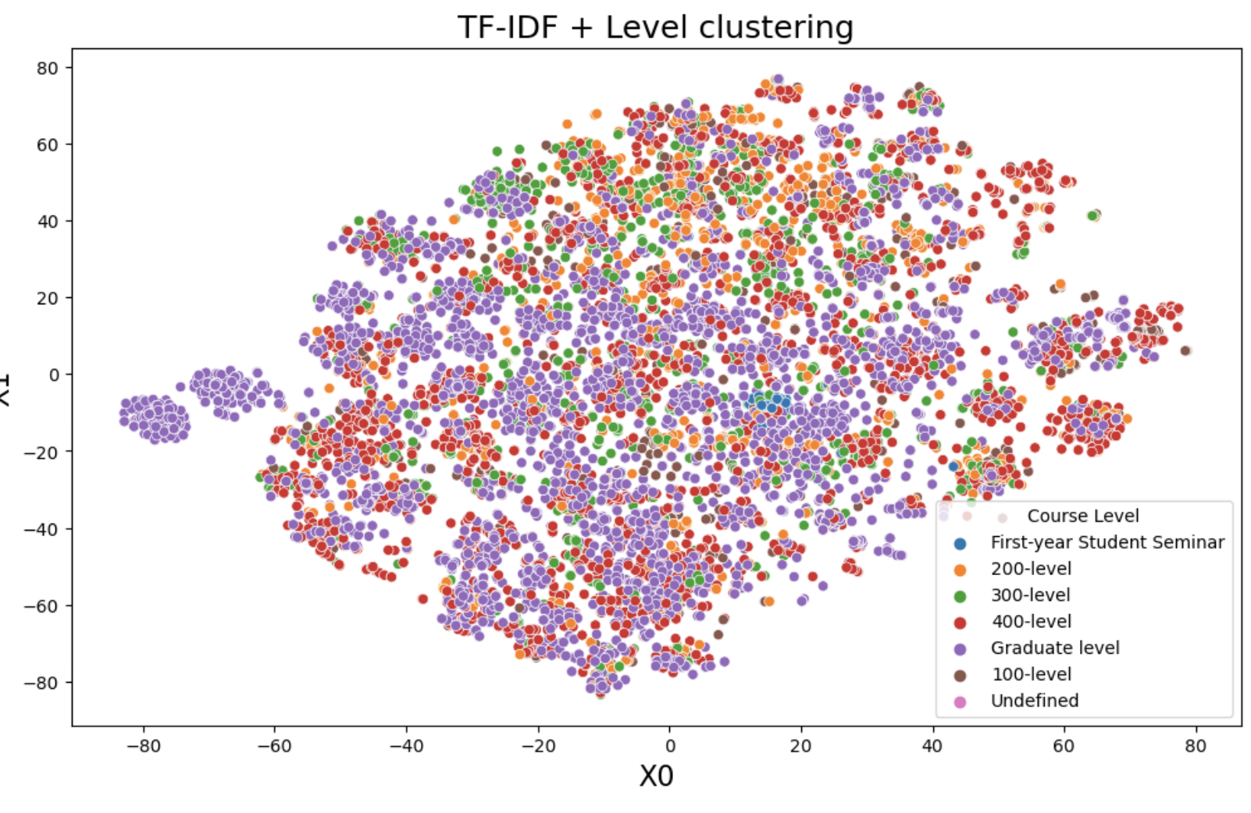
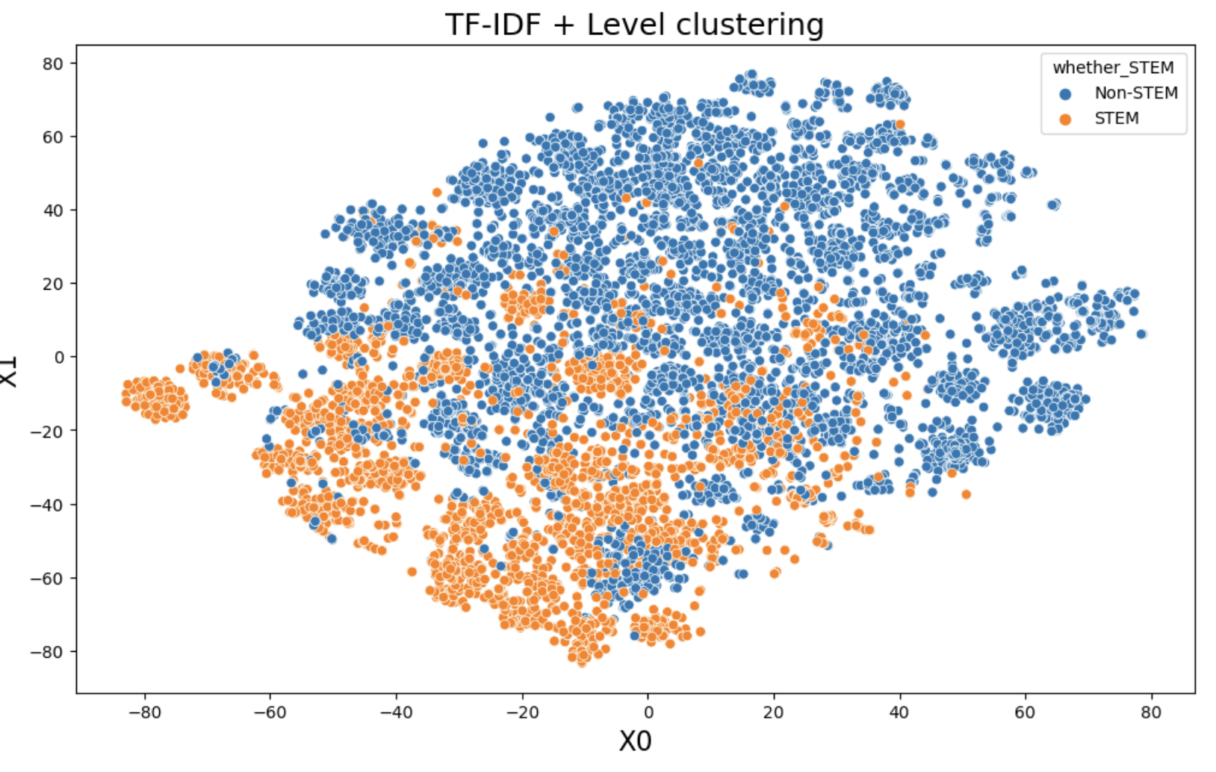
Some visualizations

Slide 9
Demo
https://e41ac5756b51b63628.gradio.live/

Slide 10
Future steps
Adding scatterplots into the Gradio interface.
Putting it on somewhere and open to all students.

Slide 11
Personal growth
Successfully completed a self-directed project.
Enhanced my Python coding and documentation skills.
Gained a foundational understanding of NLP through exposure to different models.
Strengthened my resume.
Improved communication skills through feedback from clients and team members.

