Slide 1
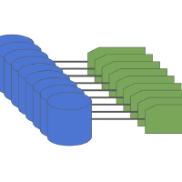
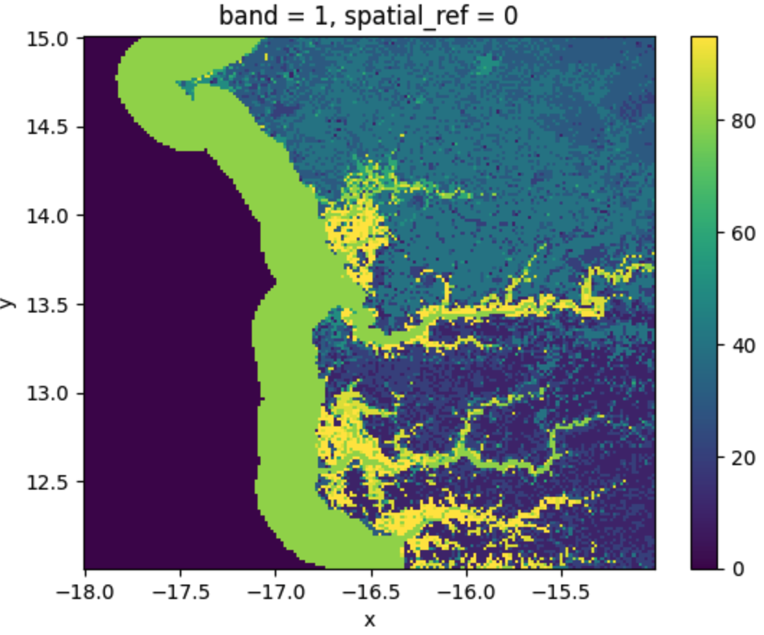
LEM data flow
Tif-to-np function [sampling] (mins)
Cloud VM script
[packaging]
(~3hrs)
Earth
Engine
[fetching] (~24 hrs)
Training
ESA WorldCover tile
File type: geotiff
Dims:
Location: AWS public url
EO data
File type: geotiff
Dims: 256 x 256 x 18 b x 24 m
Location: gs://lem-tifs/tifs
Spec: 3040 files at 70-90mb
Total: 220.06 GB
Notes:
The entire tile is a polygon not a box (e.g. nan ocean data is skipped)
256x256 dimensions must be used to allow file to fit in tif-to-np cloud function memory
Sampled EO data
File type: npy
Dims: 18 b x 24 m
Source: tif-to-np cloud function
Location: gs://lem-assets/npy
Spec: 1,145,889m files at 3.5kb
Total: 3.82 GB
Notes:
Npy files are sampled every 10 pixels why is the total size reduction nearly 60x
Theories: nans + lighter encoding + cloud function scaling, float32
Webdataset shard
File type: tar
Source: Cloud VM
Location: gs://lem-assets/tars
Spec: 1 tar file at 4.4GB (in 1-10 recommended range)
Notes:
Amount of time it takes to download the data is frustrating because it’s so little

Slide 2
LEM data flow
Tif-to-np function [sampling] (mins)
Cloud VM script
[packaging]
(mins)
Earth
Engine
[fetching] (~24 hrs)
Training
ESA WorldCover tile
File type: geotiff
Dims:
Location: AWS public url
EO data
File type: geotiff
Dims: 256 x 256 x 18 b x 24 m
Location: gs://lem-tifs/tifs
Spec: 3040 files at 70-90mb
Total: 220.06 GB
Notes:
The entire tile is a polygon not a box (e.g. nan ocean data is skipped)
256x256 dimensions must be used to allow file to fit in tif-to-np cloud function memory
Sampled EO data
File type: npy
Dims: 600 x 18 b x 24 m
Source: tif-to-np cloud function
Location: gs://lem-assets/npy
Spec: 1884 files at 2MB
Total: 3.82 GB
Notes:
Npy files are sampled every 10 pixels why is the total size reduction nearly 60x
Theories: nans + lighter encoding + cloud function scaling, float32
Webdataset shard
File type: tar
Source: Cloud VM
Location: gs://lem-assets/tars
Spec: 1 tar file at 3.82GB (in 1-10 recommended range)

Slide 3
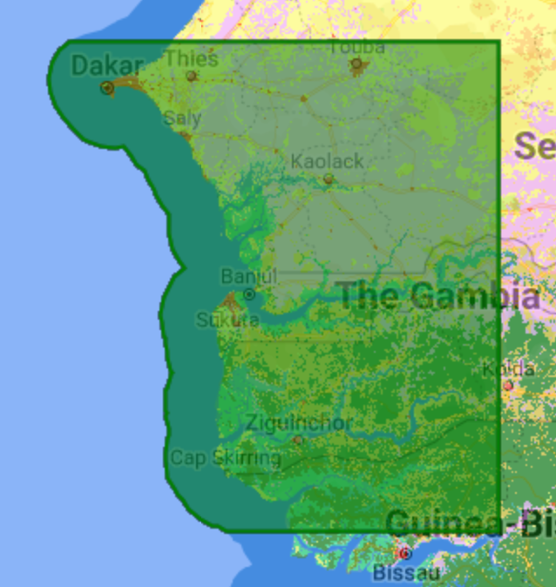

LEM data flow
2022-11-28
0
1
2
3
4
5
Training
S1_S2_ERA5_STRM( EEPipeline )
WorldCover2020( EEPipeline )

Slide 4
LEM data flow
2022-11-28

