Slide 1

The Power of Habit
Small Changes, Big Results

Slide 2
What is a Habit?
40%
They are automatic.
Habits are the small decisions you make and actions you perform every day. Research suggests that over 40% of our daily actions are not conscious decisions, but habits running on autopilot.
of daily actions

Slide 3





The Science: The Habit Loop
All habits follow a simple 3-step neurological loop.
1. The Cue
2. The Routine
3. The Reward
The trigger that tells your brain to go into automatic mode.
The physical, mental, or emotional behavior that follows the cue.
The positive reinforcement that tells your brain this loop is worth remembering.

Slide 4
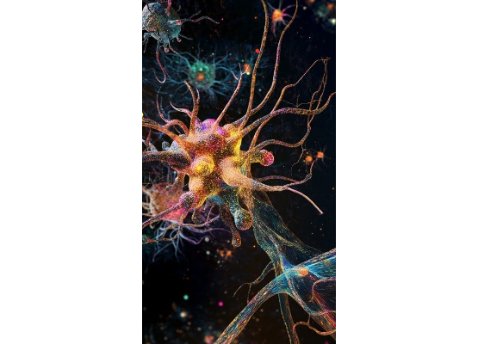
How Habits Form: Cravings
The Loop is Driven by Craving
It's not just the reward, but the *craving* for the reward that drives the loop.
Your brain starts to anticipate the reward as soon as it sees the cue. This anticipation creates a powerful urge that makes the habit automatic. Understanding this craving is the first step to changing the routine.

Slide 5
The Golden Rule of Habit Change
You can't extinguish a bad habit. You can only change it.
"
"
— Charles Duhigg

Slide 6


How to Change a Habit
Keep the Cue & Reward
An Example
The "Golden Rule" is to keep the same cue and the same reward, but *change the routine*.
Cue: Feeling stressed at 3 PM.
Old Routine: Eat a cookie.
New Routine: Take a 5-minute walk.
Reward: A break from work, a change of scenery, and mental relief.
This satisfies the brain's craving without the negative consequences of the old habit.

Slide 7


Find Your "Keystone Habit"
The Ripple Effect
Some habits are more powerful than others. Keystone habits are small changes that create a ripple effect, transforming other areas of your life.
They establish small wins, which build momentum for more change.

Slide 8
Examples of Keystone Habits
Exercise: People who exercise start eating better, become more productive, and show more patience.
Making Your Bed: Correlates with better productivity, stronger adherence to budgets, and a greater sense of well-being.
Food Journaling: Automatically creates awareness that leads to healthier choices and better outcomes.
Meditation: Improves focus, reduces stress, and increases emotional control throughout the day.

Slide 9
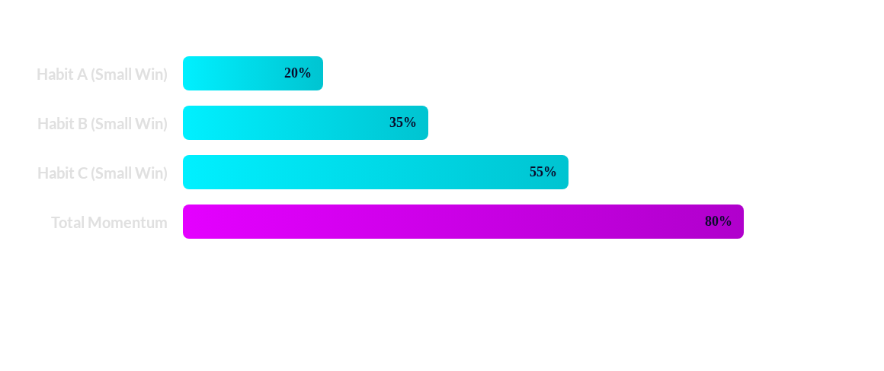
The Power of "Small Wins"
Keystone habits work because they provide small wins. These small victories build momentum, creating a culture where change becomes contagious.

Slide 10
A Framework for Change
Experiment
Have a Plan
What craving is the routine *really* satisfying? (Energy? Social?)
Consciously choose a new routine that provides a similar reward.
Identify Routine
Isolate Cue
What is the bad habit you want to change?
What triggers it? (Location, Time, Emotion, People?)

Slide 11
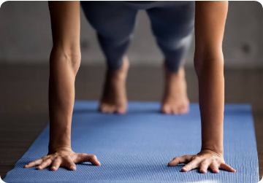
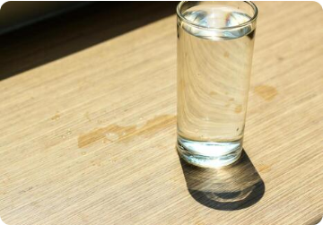
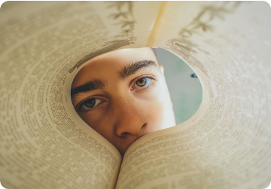
Start Small, Not Perfect
One push-up is better than zero.
One glass of water is a start.
One page read is progress.

Slide 12
Questions?
Thank You

Slide 13








Image Sources
https://images.stockcake.com/public/c/a/2/ca2ff93a-6094-4cd9-9c45-3b165ef5b260_large/colorful-neural-network-stockcake.jpg
Source: stockcake.com
https://images.byword.ai/ffm7JevXtATrUJXnNfoBdydyomfTQgehwgpil8ytJJrseDDhJA-out-0.png
Source: afjones.co.uk
https://media.istockphoto.com/id/1042985052/photo/sporty-woman-doing-plank-pose-close-up-view.jpg?s=612x612&w=0&k=20&c=8f-hVWlp692ZTvfwBBwJHspbaw307o0Eu4CQA5m1m8I=
Source: www.istockphoto.com
https://static.vecteezy.com/system/resources/thumbnails/008/139/046/small/clean-drinking-water-in-the-glass-on-wooden-table-with-the-sun-shining-through-the-window-free-photo.jpg
Source: www.vecteezy.com
https://miro.medium.com/1*zGBhmsH5qvYPBqLU7I1UYA.jpeg
Source: tuckerlieberman.medium.com

